Slide 1







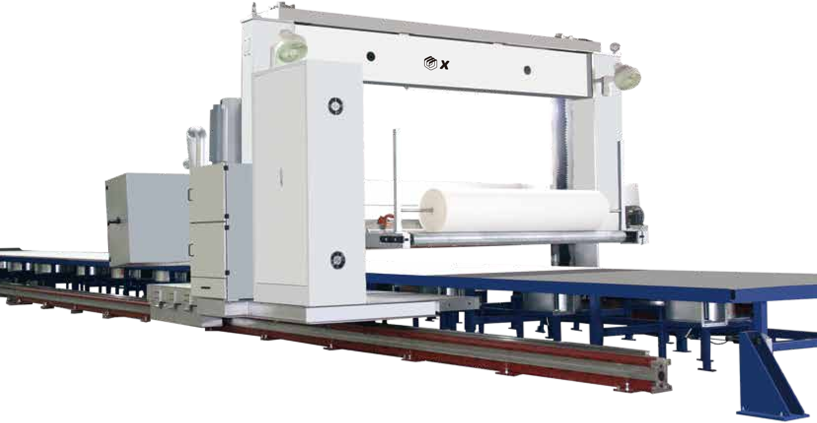



SPONGE CUTTING
专业海绵切割设备服务商
ximmei
扫码进入官网了解更多详情
Imei
●
xim e
青岛新美腾海绵机械制造有限公司
Qingdao xinmei sponge Machinery Manufacturing Co. , Ltd.
电话：0532-8775 5602 0532-8776 0291
手机：136 0896 3598 187 2472 1198 136 0648 1969 +86-158 6687 2938 +86-186 6165 6953
邮箱： contact@xinmeiteng.cn huchuansen@gmail.com
地址：山东省青岛市城阳区京口社区京口工业园1180号东南
网址：www.xinmeiteng.cn
TEL： 0532-8775 5602 0532-8776 0291
Phone： 136 0896 3598 187 2472 1198 136 0648 1969 +86-158 6687 2938 +86-186 6165 6953
E-mail： contact@xinmeiteng.cn
ADD： Chengyang District,Qingdao,China
Web： https://www.foamcutting-machines.com/
青岛新美腾海绵机械制造有限公司
Qingdao xinmei sponge Machinery Manufacturing Co. , Ltd.

Slide 2



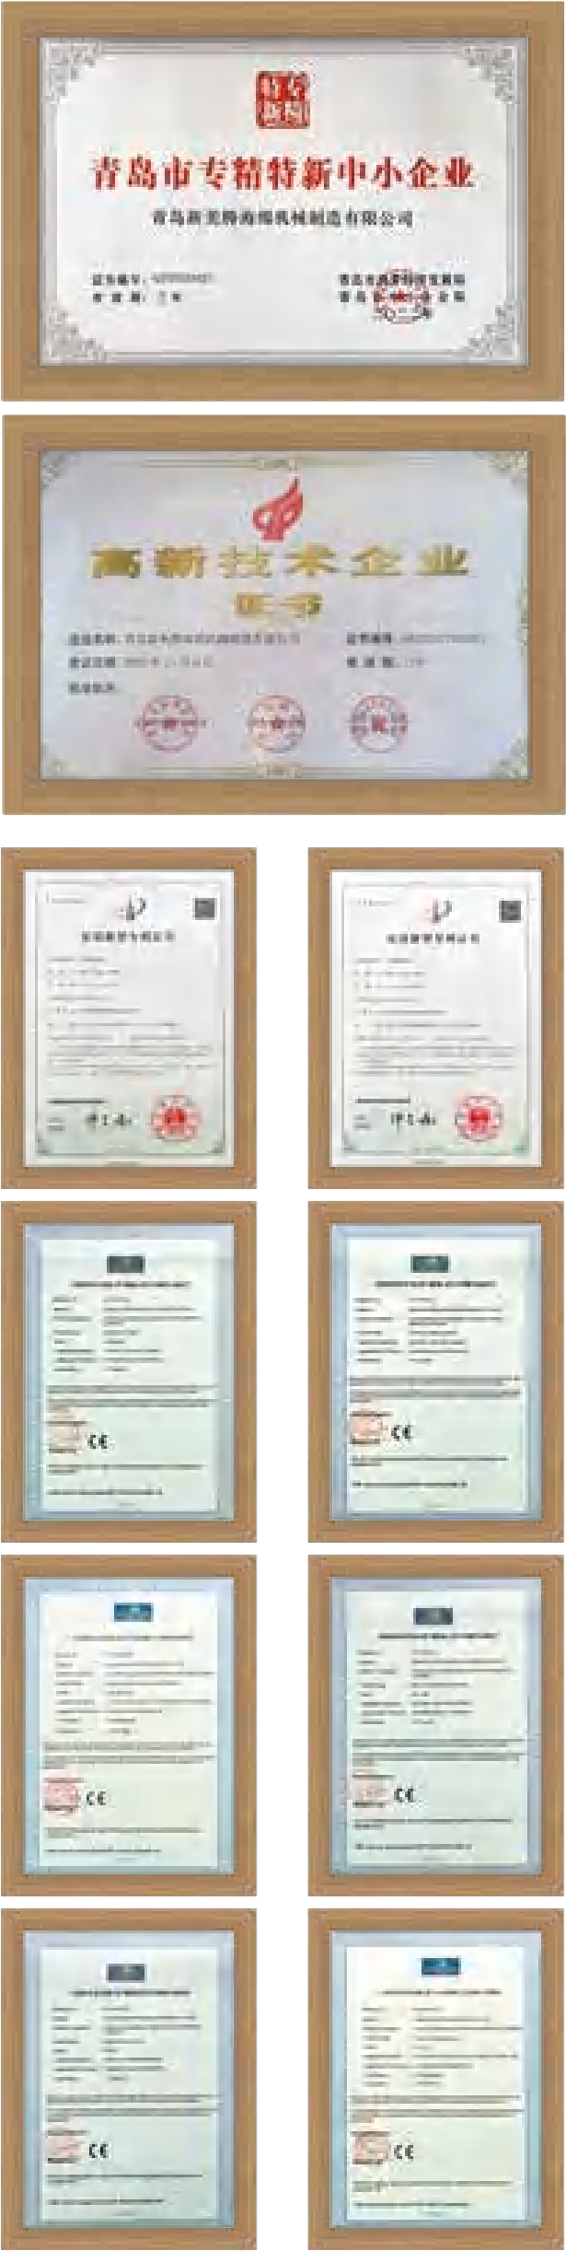
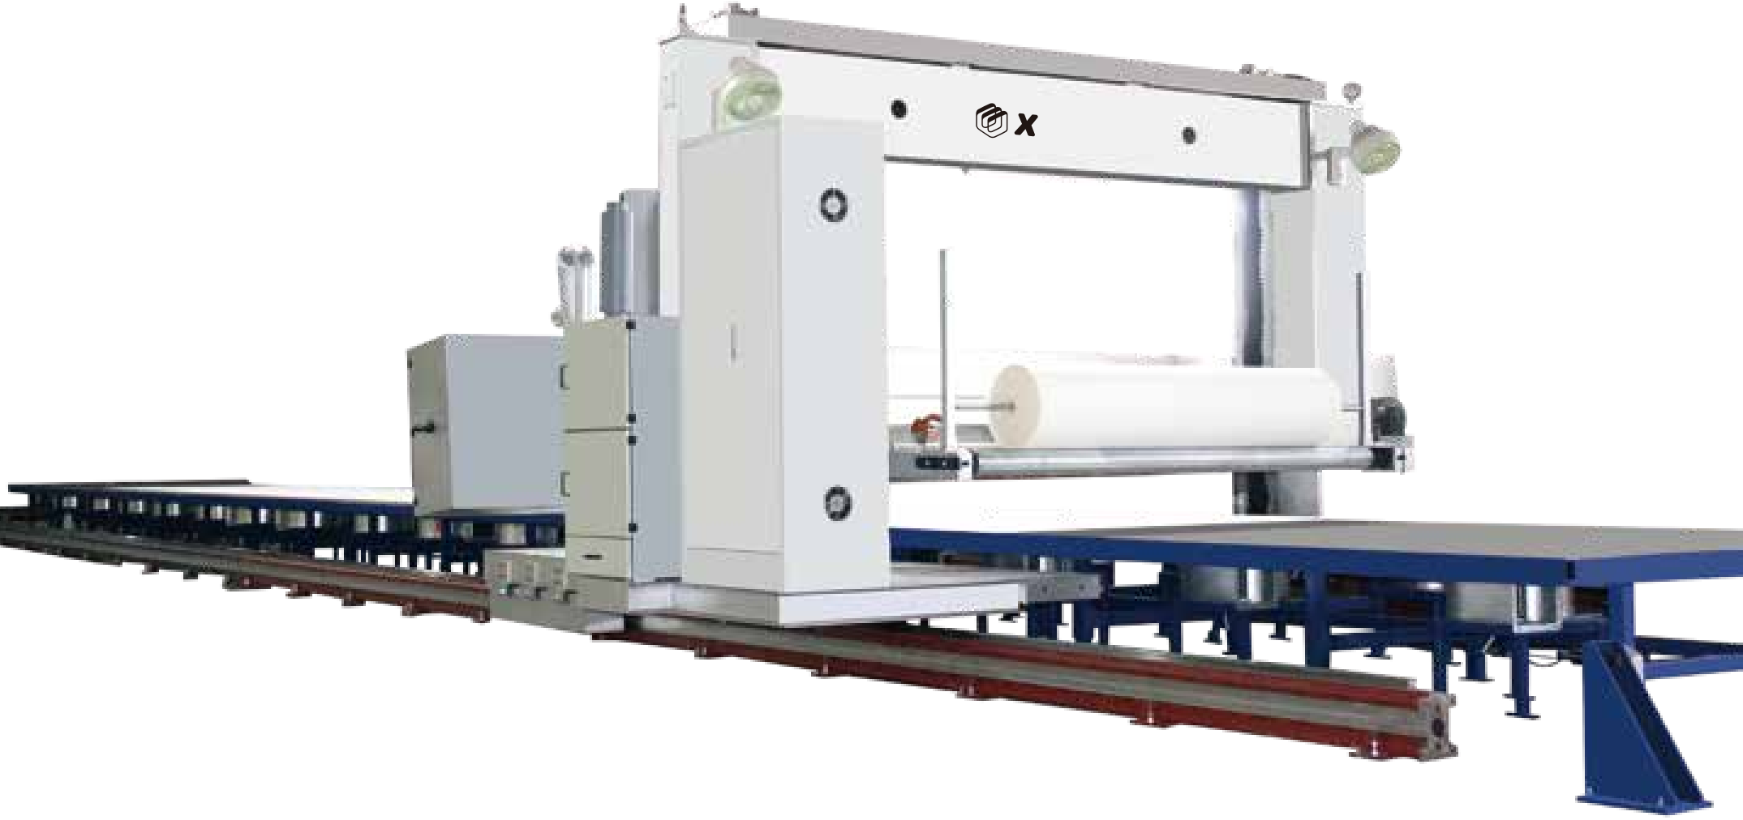
切割系列 CUTTING SERIES
企业简介 COMPANY PROFILE
C517路轨平切机
C517 Linear motion Guide Long foam block Horizontal Cutting Machine
C517 路轨平切机是我公司最新自主研发的高精度海绵路轨切割机，本机主要把无限长的平泡切割成无限长的薄片海绵进行复合，本机采用伺服 电机，路轨采用直线导轨，平台采用吸风吸附。配置自动顶刀，自动磨刀，切割运行平稳，切割精度高，噪音小，切割速度快，效率更高。
青岛新美腾海绵机械制造有限公司创始于 2000 年，是一家专业生产海绵
切割加工设备的高新技术企业。
十余年来，公司坚持创新驱动发展， 以客户、市场为导向，专注自主创新 体系，致力于为全球客户提供卓越的产品和服务。主要产品有：切割、异形切割、 发泡、再生复合、粉碎、自动化等十余个系列，50 余个品种产品。公司拥有国 内外顶级加工设备 20 余台，设备投资 1000 余万元，加工精度达到国际先进 水平。同时汲取国际先进的管理机制，产品均已通过 ISO9001、2000 国际质 量管理体系认证和 CE 认证，并荣获青岛市专精特新中小企业殊荣。
公司始终秉承“质量求生存、信誉求发展”的经营理念， 以高标准、严要 求把控产品品质，得到了社会的认可，产品畅销全球并出口欧洲、美洲、亚洲、 大洋洲、非洲等地区。公司将不断为合作伙伴提供更加完美的解决方案，更加 优质的产品，创造更多的价值！
Qingdao Xinmeiteng Sponge Machinery Manufacturing Co., Ltd. was founded in 2000, is a professional production of sponge cutting processing equipment of high-tech enterprises.
For more than ten years, the company has adhered to innovation-driven development, customer-oriented and market-oriented, focused on independent innovation system, and committed to providing excellent products and services for global customers. The main products are cutting, profiled cutting, foaming, rebonded,laminating, crushing, automation and other more than 10 series, more than 50 varieties of products. The company has more than 20 sets of domestic and foreign top processing equipment, equipment investment of more than 10 million yuan, processing accuracy reaches the international advanced level. At the same time to absorb the international advanced management mechanism, the products have passed the ISO9001, 2000 international quality management system certification and CE certification, and won the Qingdao special small and medium-sized enterprise award.
The company has always been adhering to the "Survive by quality, Credibility for development"business philosophy, with high standards, strict requirements to control product quality, has been recognized by the society, products sold all over the world and exported to Europe, America, Asia, Oceania, Africa and other regions. The company will continue to provide partners with more perfect solutions, more quality products, and create more value!
C517 Linear motion Guide Infinite Long sheet high speed precision Horizontal Cutting Machine is our latest independent R&D high-precision long foam horizontal cutting machine. Mainly reciprocating cutting the unlimited length of foam
block into slice for laminating. It adopts servo motor, the travel- ing rail adopts linear guide, the platform using vacuum suction. Equipped with automatic knife entry feeding and grinding, the cutting runs so smoothly, with higher cutting precision, low noise, fast cutting speed and higher efficiency.
型 号 Type number | C517
切割厚度 Cutting thickness | 0.5-70mm
切割宽度 Cutting width | 2200mm
切割高度 Cutting height | 1300mm
切割速度Cutting speed | 0-120m/min
切割精度Cutting tolerance | 0.5-3mm ±0.05mm
主机电机功率Main motor power | 25KW
主机重量Main unit weight | 8T
主机外形尺寸（长*宽*高） Main unit dimensions（L*W*H） | 6500*3000*2600mm
ImEi
●
01/02

Slide 3









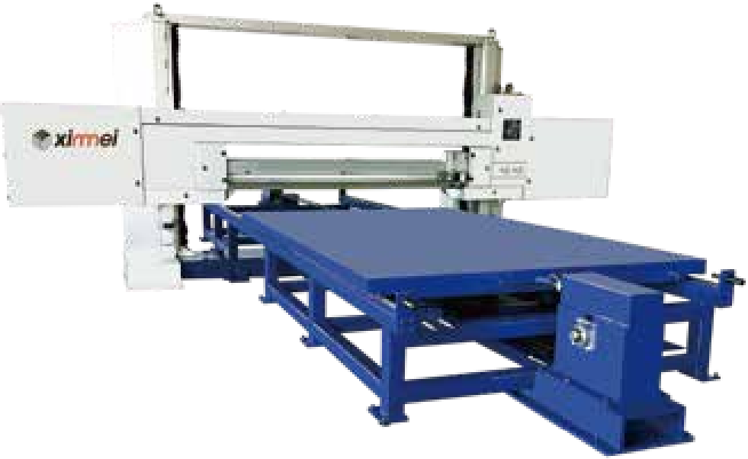
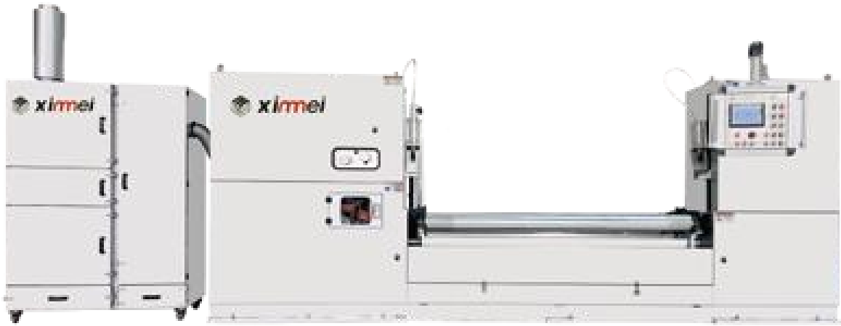







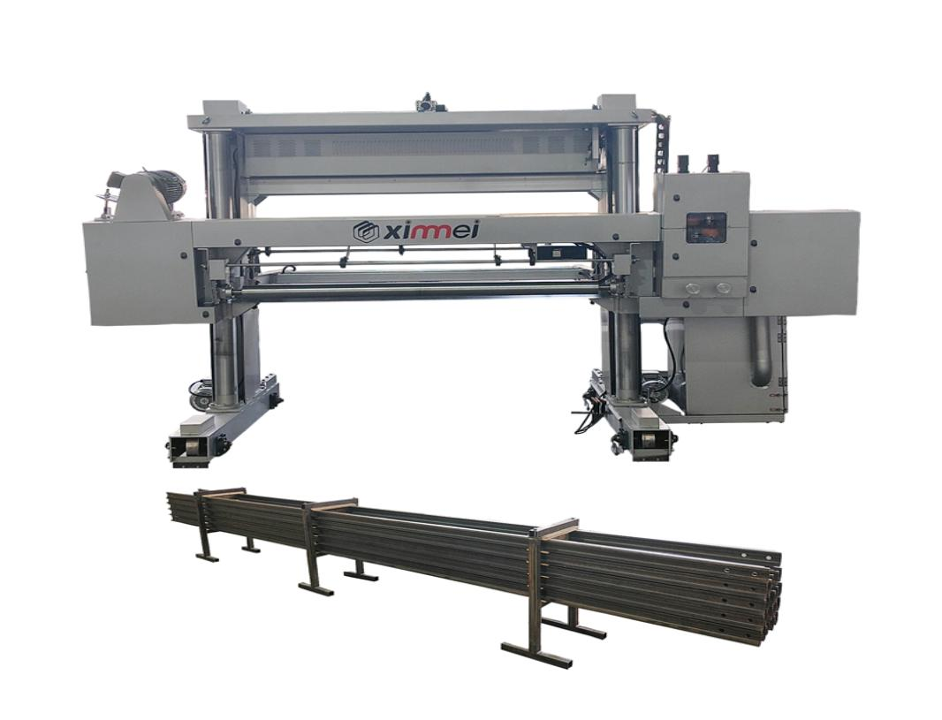
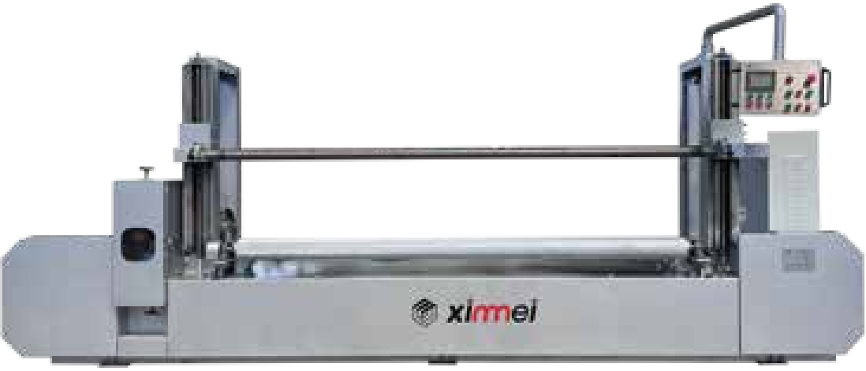
XInnneJ
切割系列 CUTTING SERIES
TDPB-1900 High-end Cylinder foam Peeling machine
TDB-2200 High-end automatic Horizontal Splitting machine
机身全钢板 , 重量大稳定性高。轮子采用合金钢 , 硬度高达 HRC60 以上 , 耐磨损 , 使用寿命可达十年以上。刀板采用高速合金钢 , 硬度达到 HRC60, 使用寿命可达八年以上。顶刀装置采用先进技术 , 可以自动顶刀 , 也可单个手动微调 。前海绵托辊可以自动上升 , 无需人工操作 , 尾部切割更 精准。轮子随刀带磨损自动向前移动 , 保持每个顶刀接触面受力均匀 。数控系统采用全套西门子系统 , 稳定可靠 , 切割精度准 , 切割速度高。
The basis frame is full steel plate, high weight and high stability. Band knife wheel made by alloy steelhardness up to HRC60 above, wear- resis-tant, service life can be more than ten years. The knife holder plate is made of High-speed Steel, the hardness reaches HRC60 ° , the usage life can be more than eight years. The knife pushing device adopts advanced technology, can automatically feeding knife but also can be
manually fine-tuned individually. The front sponge roller can rise automatically without manual operation, and more precise cutting at the end tail. The band knife wheels move forward automatically with the wear of the knife belt to keep the force on each knife contact surface uniform. CNC
adopts a full set of Siemens system which is stable and reliable, with accurate cutting precision and high cutting speed.
本机采用全伺服电机控制 , 切割精度高 , 切割速度快 , 把块状海绵切成片状 , 便于其他设备加工生产 , 与其他机器的不同点在于增加了自动磨刀 、 自动顶刀 , 磨刀室增加了吹气清洁功能和照明装置 , 用于 PU 海绵加工行业。
This machine is controlled by a full set of servo motors, high cutting precision and fast cutting speed. Cut the block sponge into sheets , easy for other processing equipment of production, the difference with other horizontal cutting machine in our factory is the increase of auto -matic knife grinding, automatic knife entry feeding, grinding unit increased dust blowing cleaning function and lighting device. For PU
sponge processing industry.
切割宽度 cutting width | 500 - 2300mm
切割速度 cutting speed | 16om/min( no cutting marks )
切割直径 cutting diameter | 20-1600mm
切割厚度 cutting thickness | 0 . 5 - 30mm
切割精度 cutting accuracy | 0.5-3mm ±0.05mm
电机功率 Motor power |  | 1 6kw
机器 重量 Machine weight | 4000kg
外形尺寸(长 宽x高) overall dimension(LXWXH) | 5000x2500x2000mm
切割泡体尺寸 Cutting size (长x宽x高) | 3000x2200x 1 250mm
切割厚度 cutting thickness | 0 . 5 - 70mm
切割厚度误差cutting thickness tolerance | 0 . 5 - 2mm <士0 . 05
总功率Motor power | 23kw
机器重量 Machine weight | 6000kg
外形尺寸overall dimension (长 宽x高) | 8300x6200x2500mm
TDPA-2300 Peeling machine
TDPA-2150 Long Foam Rail track Moving Horizontal Splitting Machine
本机采用国内先进的数控触摸屏装置 , 该装置可以直接通过输入数字来控制切割厚度 , 不用交换齿轮或者更换齿轮 , 与传统的圆切机相比 , 它具 有切割厚度更薄 , 切割精度更高 , 切割速度更快 , 机器的故障更少的优点 , 大大提高了产品的质量和工作效率。
This machine adopts the China's advanced CNC touch screen device, it can directly control the cutting thickness by inputting numbers, without exchanging or replacing gears, compared with the traditional peeling cutter, it has the advantages of thinner cutting thickness, higher cutting precision, faster cutting speed and fewer failures of the machine, which greatly improves the quality of the products and the working
本机主要用于无限长 PU 泡绵的无限长切片工作 , 切割出的产品主要用于海绵和其他材料复合 , 本机采用进口变频调速控制技术 , 运行平稳、切 割精确、生产效率高 , 是连续自动发泡的必备配套设备。
This machine is mainly used for unlimited length PU foam infinite length slicing work. The cut products are mainly used for sponge and other materials lamination. This machine adopts imported frequency conversion speed control technology, smooth operation, cutting preci- sion, high production efficiency, is the necessary set equipment for continuous automatic foaming.
efficiency.
切割宽度 cutting width | 500 - 3000mm
切割速度 cutting speed | 0 - 130m/min(no cutting marks )
切割直径 cutting diameter | 20 - 1 500mm
切割厚度 cutting thickness | 1 - 30mm
切割精度 cutting tolerance | 1-3mm ±0.08mm
电机功率 Motor power | 8 . 69kw
机器重量 Machine weight | 2000kg
外形尺寸(长 宽x高) overall dimension(LXWXH) | 5000x2500x2000mm
切绵宽度/cutting width | 2200mm
切片厚度/slice thickness | 1 . 5 ~ 70mm
切割高度/cutting height | 1300mm
行走速度/Moving speed | 0 ~ 60m/min
电机功率/Motor power | 14. 89kw
机器重量/ Machine weight | 2800kg
机器外形尺寸(长x宽x高) External size (LXWXH) | 4300x21 00x2200mm
03/04

Slide 4




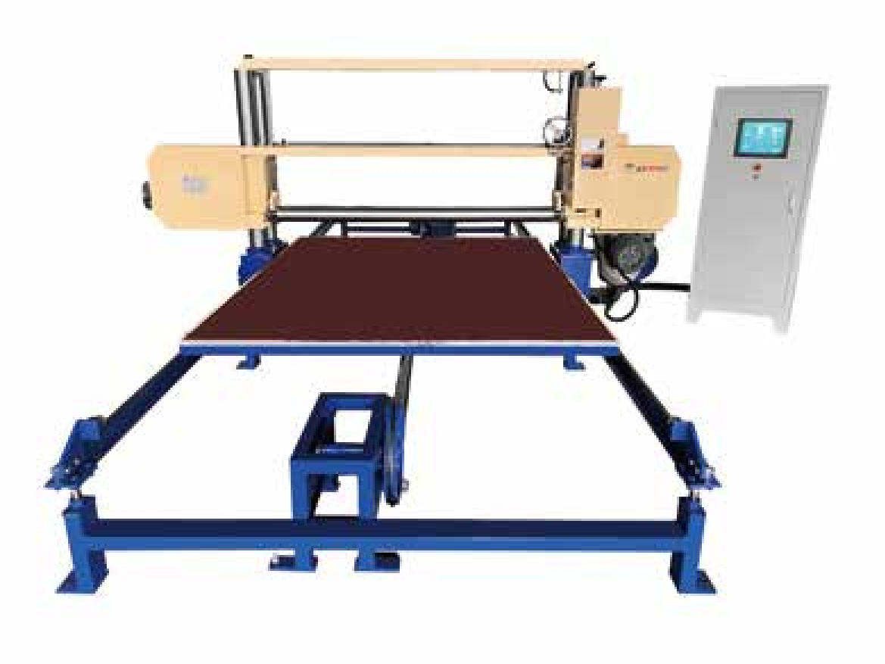
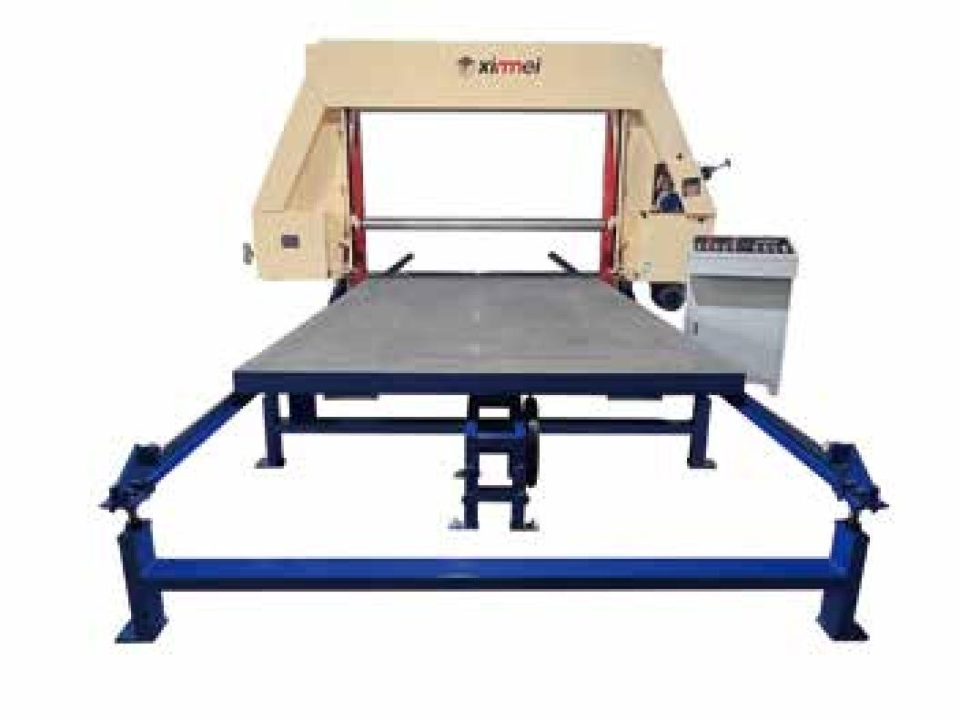




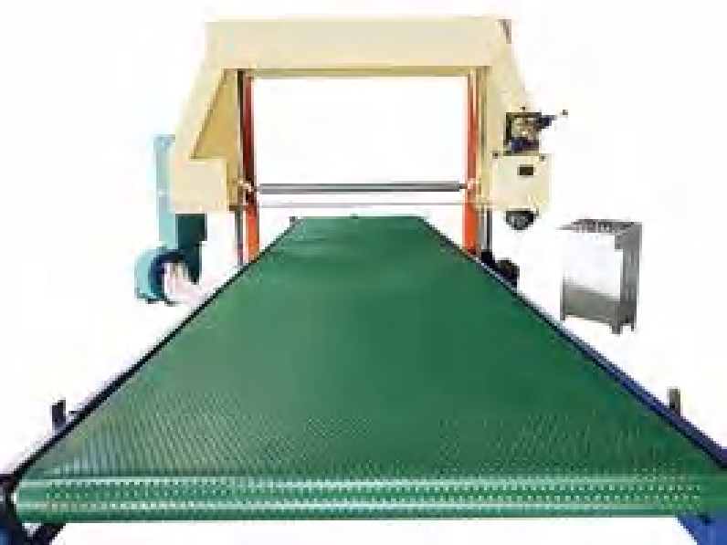
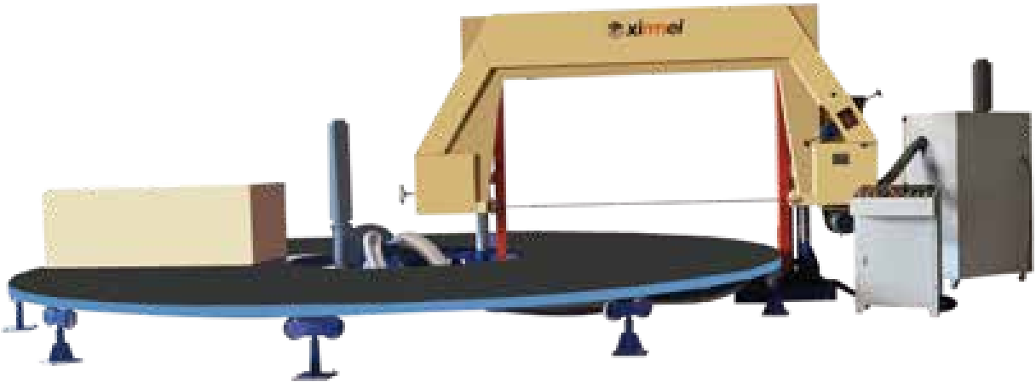
XInnneJ
切割系列 CUTTING SERIES
TDP-2150 Horizontal Splitting Machine(with air suction)
TDA-1650/2150 Horizontal Splitting Machine for hard or rebond sponge
这种切割机主要是把块状泡绵切成薄片 , 工作台采用全自动数字控制 , 并带有吸风装置 , 在切割过程中增加平台与海绵的摩擦力和吸附力 , 可以 使海绵的切割更精准。根据需要切割的厚度和泡绵的密度 , 通过触摸屏设定数值 , 工作台自动往复运动切割出所需尺寸 , 刀带切割角度可从 。"调到 5" 。 切厚绵时 , 为了防止切割的泡绵滑动 , 可加压辊装置 , 使切割厚度更精准。
This kind of cutting machine is mainly to splitting the block foam into thin slices, the worktable adopts automatic digital control, and with
suction device, increase the friction and adsorption between the worktable and the sponge during the cutting process, which can make the sponge cutting more accurate. According to the thickness to be cut and the density of the foam, set the value through the touch screen, the
table automatically reciprocally to cut to the required size, the band knife belt cutting angle can be adjusted from 0°to 5° . When cut thick foam, in order to prevent the cutting of the foam sliding, can be added to the pressure roller device, so as to make the cutting of the thickness
本机采用当前最先进的进口变频调速控制技术 , 刀板加厚 , 主要用于硬泡绵及再生绵的水平切片工作 。本机全自动数字控制 , 操作简便 , 切 割精确 。
This machine adopts the most advanced imported frequency conversion speed control technology, the band knife holder is thickened, mainly used for hard or rebond foam horizontal slicing work. This machine is fully automatic digital control, easy to operate, cutting precision.
of a more accurate.
切片厚度 Slice thickness | 1 ~ 1 00mm
切割尺寸(宽 长) Cutting size (WL) | 1 650x2000mm 21 50x3000mm
工作台移动速度work table moving speed | 0 ~ 30m/min
电机功率 Motor _{power} | 7 . 94kw
机器重量 Machine weight | 2600kg
外形尺寸(长 宽x高) overall dimension(LXWXH) | 8000 4200x2400mm
切割高度 cutting height | 1250mm
切割尺寸 cutting size (WXL) | 21 50x3000mm
切割厚度 cutting thickness | 2 ~ 300mm
功率 power | 13.54 kw
机器重量 Machine weight | 3000kg
外形尺寸(长×宽x高) overall dimension(LXWXH) | 7000 4000x2500mm
TDSA-2150 Soft belt Conveyor table Horizontal Splitting Machine(with suction)
TDP-70 Carousel Splitting Horizontal cutting Machine(with suction)
这种切割机主要把块状泡绵切成薄片 , 整机采用全自动数字控制 , 根据需要切割厚度 , 通过触摸屏设定厚度数值 , 工作台自动往复运动 , 切割成所 需厚度 , 刀带切割角度能够从 。"调到 52。切厚绵时 , 为了防止切割的泡绵滑动 , 可加压辊 , 本机器是软带输送 , 便于链接其他切割机器。
This cutting machine is mainly to cut the block foam into thin slices, the whole machine adopts automatic digital control, according to the need to cut thickness, set the thickness value through the touch screen, the work table automatically reciprocating movement, cut into the required thickness, band knife cutting angle can be adjusted from 0 ° to 5 ° .When cutting thick foam, in order to prevent the cut foam from sliding, can be added pressure roller, the machine is a soft belt conveyor, easy to link with other cutting machines.
本机圆盘驱动采用变频调速控制 , 切割厚度PLC触屏控制 , 可靠性高 , 切割精确 。本机主要用于多个PU 方泡绵的 次性水平切片工作 , 连续切割 , 不用退刀 , 生产效率更高。
It adopts frequency conversion speed control to drive the disk table, PLC touch screen to control the cutting thickness, high reliability and precise cutting. This machine is mainly used for one-time horizontal slicing work of multiple PU block foam, continuous cutting, no need to exit knife, higher production efficiency.
切绵尺寸 Cutting size | 2000x3000mm
工作转盘转速 Work table rotation speed | 0 ~ 3 . 5r/min
刀带周长 Band knife length | 1 0000mm
切片厚度 Cutting thickness | 2 ~ 1 50mm
切割高度cutting height | 1 250mm
电机功率 Motor power | 22kw
机器重量 Machine weight | 4000kg
外形尺寸(长 宽x高) overall dimension(LXWXH) | 8000x7000x2400mm
切割高度 Cutting height | 1300mm
切割尺寸 Cutting size | 3000x2000mm
切割厚度 Cutting thickness | 2 - 300mm
切割速度 cutting speed | 0 - 50m/min
功率 Motor power | 1 7 . 84kw
机器重量 Machine weight | 3500kg
外形尺寸(长 宽x高) overall dimension(LXWXH) | 7000x4500x2500mm
05/06

Slide 5







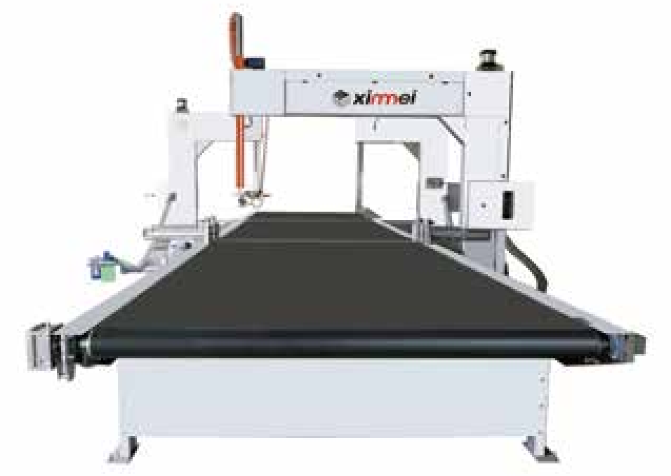
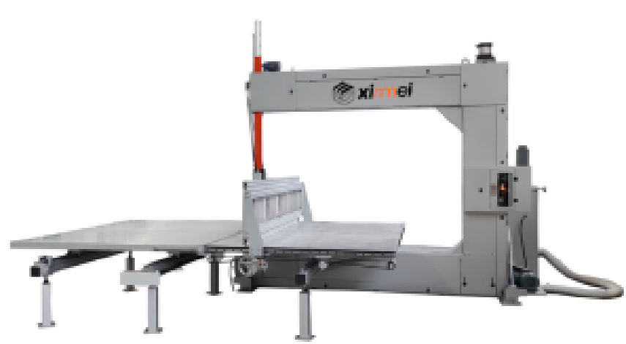







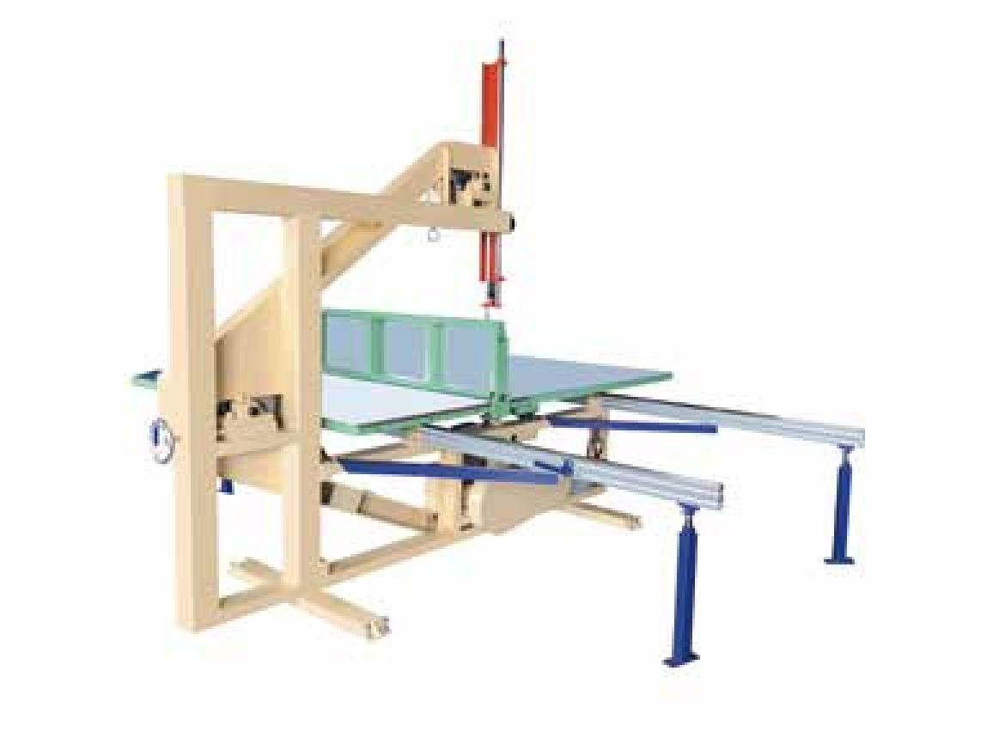
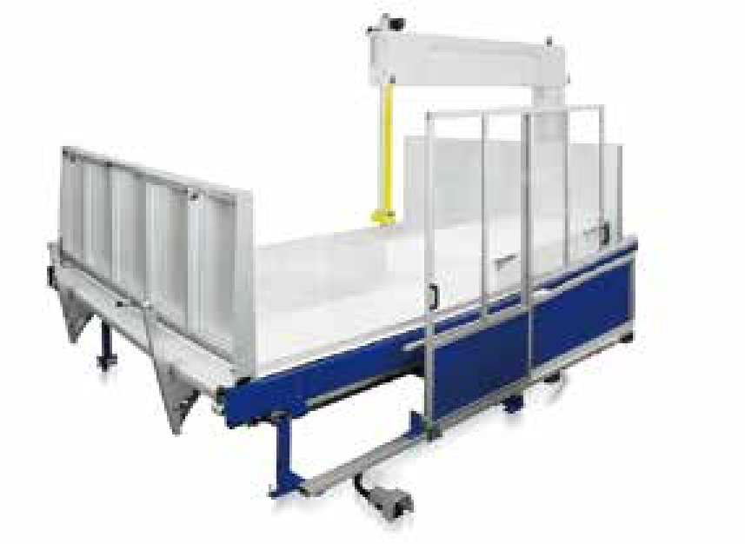
XInnneJ
切割系列 CUTTING SERIES
TDC-4
TDC-4 Vertical Cutting Machine
TDPF-03 Fully automatic Vertical cutting machine
本机主要用于 PU 海绵 , EVA, PE , EPE 等材料的精加工 , 主要把整张海绵 、PE、EVA , EPE 等材料 , 切割成所需要大小不等的方形或长方形尺寸 , 在触 摸屏上输入所需要的长宽尺寸 , 就能 次性不停机完成切割所需要的尺寸 , 切割精度高 , 刀带使用寿命长 , 操作简单 , 切割不需要 CAD 绘图 , 做到省工 省时 , 效率高。
This machine is mainly used for PU sponge EVA PE EPE and other materials fine finishing. It mainly cut the whole block of sponge, PE, EVA, EPE and other materials into the required size of the square or rectangular size. Input the length and width of the size by the touch screen, can be a one-time non-stop to complete the cutting of the required size with high cutting accuracy. Long service life of the band knife, easy to
本机主要用于 PU 泡绵垂直切块和切条工作 , 同时可加工各种纸类 EVA、PE、纸板及 珍珠绵 。
This machine is mainly used for PU foam vertical cutting into block and strip work, also can process all kinds of paper ,EVA, PE, cardboard and EPE.
operate, cutting without the CAD drawing, to save labor and time, very high efficiency.
型号Model number | 标准Normal | 加大oversize
内工作台尺寸 Inner table dimensions(LxW) | 2500x1320mm | 2500x1 630mm
外工作台尺寸 External table size(LxW) | 2500x1800mm | 2500x2000mm
切割高度 cutting height | 1 250mm | 1250mm
电机功率 Motor power | 2 . 38kw | 2 . 38kw
机器重量 Machine weight | 1800kg | 1900kg
外形尺寸(长 宽x高) overall dimension(LXWXH) | 4000x4000x2500mm | 4300x4000x2500mm
可切泡尺寸(长 宽 高) Cutting size (LXWXH) | 3000x2200x 1250mm
工作台尺寸(长 宽) Table size (LxW) | 7000x2300mm
切割速度 cutting speed | 0 - 50m/min
切割误差(长 宽) cutting tolerance (LxW) | 士0 . 5mm , 士0 . 5mm
电机功率 Motor power | 7kw
机器重量 Machine weight | 4000kg
外形尺寸（长×宽×高）Overall dimension(L×W×H） | 7000×6000×2500mm
TDP-4LS automatic Vertical Splitting machine
TDA-3L Vertical Cutting Machine
本机采用刀架来回移动 , 平台上挡板来回移动 , 工作台固定的形式 , 将泡绵块夹持在两块挡板之中 , 可移动的切割刀架在直线导轨上作往复运动 , 根据所需切割宽度从而挡板左右移动 , 形成对泡绵体等进行往返垂直切割工作。可自动切割成块状或条状 , 此机器还采用了伺服调速 PLC 自动控制系 统 , 能通过控制面板自动控制切割宽度和速度以及刀架挡板的来回移动 , 具有自动化程度高、切割精准、操作安全、省工省时、无需人工看守。
This machine adopts the form that the knife frame moves back and forth, the baffle plate on the worktable moves back and forth,
and the worktable is fixed. Foam block clamped in the two baffles, movable cutting knife frame in the linear guide for reciprocating motion, according to the required cutting width and thus baffle left and right movement, such as foam body back and forth vertical cutting work,
can be automatically cut into blocks or strips. This machine also adopts servo speed control PLC automatic control system,
which can automatically control the cutting width and speed and the back and forth movement of the band knife frame and stop baffle
本机主要用于 PU 泡绵垂直切块和切条工作。本机同时可加工各种纸类 EVA 、PE 、纸板及珍珠绵。
This machine is mainly used for PU foam vertical cutting into block and strip work, also can process all kinds of paper, EVA, PE, cardboard and EPE.
odel number | 标准Normal | 加大oversize
台尺寸 Inner table dimensions | 1 320x2500mm | 1 650x2500mm
台尺寸 External table size | 1 800x2500mm | 2000x2500mm
度 cutting height | 1250mm | 1250mm
度 Band knife length | 6900mm | 7600mm
率 Motor power | 1 . 68kw | 1 . 68kw
量 Machine weight | 1000kg | 1100kg
寸(长 宽x高) II dimension(LXWXH) | 4000x4000x2500mm | 4350x4000x2500mm
plate through the control panel. It has high level of automation, accurate cutting, safe operation, labor-saving and time-saving, and no need for human supervision.
型号M
内工作 外工作 切割高 刀带长 电机功 机器重
外形尺
overa
内工作台尺寸/Internal table size(LxW) | 2300x2400mm
外工作台尺寸 External table size(LxW) | 2400x2400mm
切割海绵尺寸 cutting sponge size(LXWXH) | 2000mmx2000mmx 1250mm
切割海绵厚度 cutting sponge thickness | 2 - 1 250mm
总功率 Gross power | 6 . 08kw
机器重量 Machine weight | 2500kg
外形尺寸(长 宽x高) overall dimension(LXWXH) | 5000x2600x2500mm
07/08

Slide 6




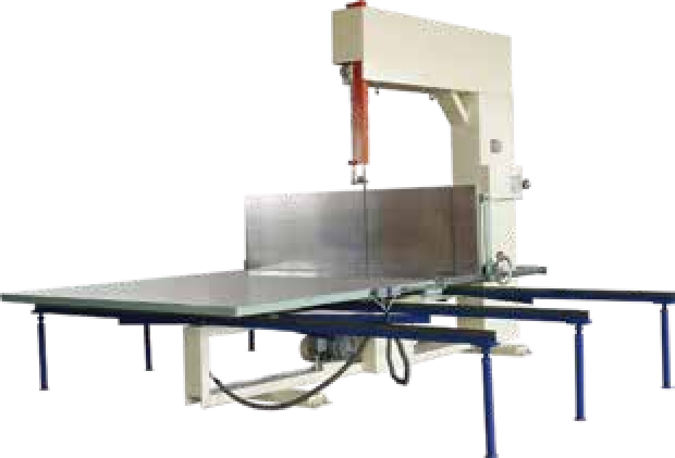
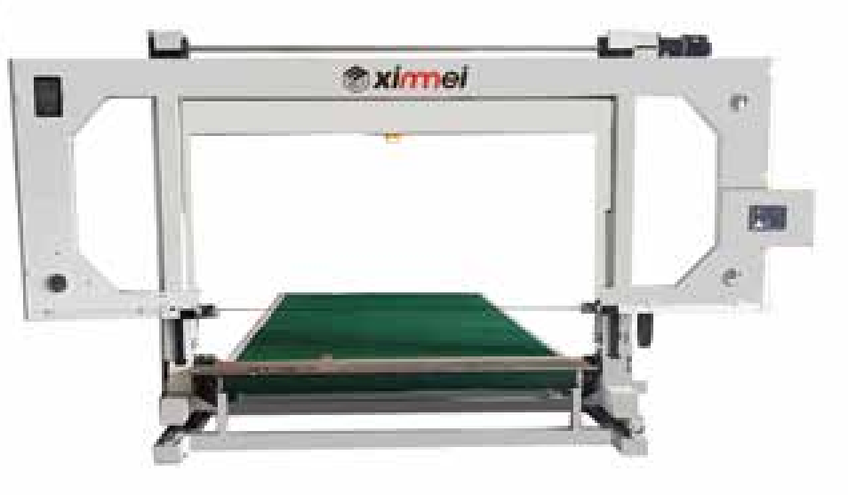




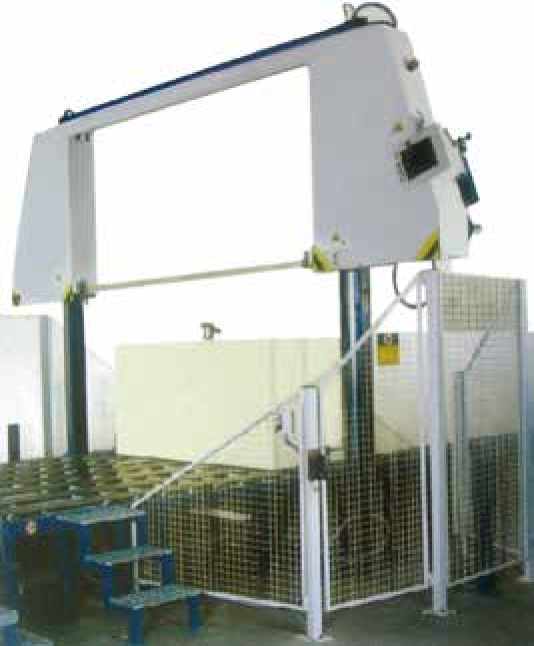
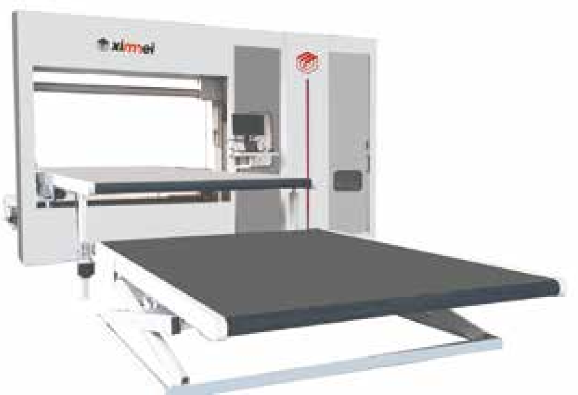

XInnneJ
切割系列 CUTTING SERIES
TDPO-2.2 CNC Revolving loop knife Contour cutting machine （horizontal cutting knife）
TDP-4L Vertical Cutting Machine
本机主要用于泡绵垂直切片及泡绵成型的切片工作 , 同时可加工各种纸类 EVA、PE、纸板及珍珠绵。
This machine is mainly used for foam vertical slicing and foam molding slicing work, as well as processing a variety of paper, cardboard, EVA, PE and EVE.
微齿刀的利用避免了再磨刀 , 切割质量精度更高 , 切割速度更快。用于批量 PU 海绵、乳胶海绵的切割 , 适用于汽车、家具、室内装饰行业 , 可切割异 形、片材 , 有很高的生产效率。
The using of micro-toothed knife avoids re-grinding, higher precision of cutting quality and faster cutting speed. Used for batch PU
sponge, latex sponge cutting, suitable for automobile, furniture, interior decoration industry, can cut profiled and sheet materials with high production efficiency.
型号Model | 标准(Normal) | 加大(oversize)
内工作台尺寸(宽x长)Inner worktable size(WXL) | 1320x2500mm | 1 650 x2500mm
外工作台尺寸(宽x长)outer worktable size(WXL) | 1800x2500mm | 2000x2500mm
切割高度cutting height | 1 250mm | 1 250mm
刀带长度 Band knife length | 8000mm | 9000mm
电机功率Motor power | 1 . 68kw | 1 . 68kw
机器重量Machine weight | 1800kg | 1900kg
机器外形尺寸(长x 宽x高) Machine external size(LXWXH) | 4000x4000x2400mm | 4350x4000x2400mm
切割尺寸 cutting size | 6000x21 00mm
切割高度 cutting height | 1300mm
刀带行走速度 Band knife running | 0 - 70m/min
加工精度 Precision tolerance | ±0 . 5mm
最小切割半径 Minimum cutting radius | 1 0mm
电机总功率Total motor power | 8 . 5kw
机器重量 Machine weight | 3 . 5ton
外形尺寸(长 宽x高) overall dimension(LXWXH) | 8000 5000x2700mm
TDC-01 Long Foam block Cut to length Machine
TDPH-2.3 CNC Revolving circulating knife Contour machine （Vertical cutting knife）
TDPH2.3 是环竖刀异形切割机 , 切割速度是振动刀切割速度的 7 -8倍 , 切割速度可达到 70 米 分钟。可切割珍珠绵、PU 海绵、PE、EVA等材料 , 适用于异形切割量大的工厂。
TDPH2.3 is a circular motions Vertical cutting knife profiled machine, the cutting speed is 7-8 times faster than the oscillating knife model , and the cutting speed can reach 70 meters/min. It can cut EPE, PU sponge,PE,EVA etc. It is suitable for factories with large amount of special-shaped profiled cutting.
本裁断机适合把发泡出来的长泡绵裁断 , 般与连续发泡线配套使 用 ; 裁断的长度由数字控制 , 很精准。
This cutting machine is suitable for cutting the needed length foam out of the long foam block, generally used in conjunction with the continuous foaming line; the length is digitally controlled, very accurate.
切割尺寸 cutting size | 3000x2200mm
切割高度 cutting height | 1300mm
刀带行走速度 Band knife running | 0 - 70m/min
加工精度 Precision tolerance | ±0 . 5mm
刀带扭转角度 Band knife turing angle | ±360'
压辊装置 Pressure roller | 可选 Optional
电机总功率Total motor power | 1 0kw
机器重量 Machine weight | 3000kg
外形尺寸(长 宽x高) overall dimension(LXWXH) | 6500x5000x3200mm
切割高度 Cutting height | 1300mm
切割宽度 cutting width | 2300mm
电机功率 Motor power | 6 . 14kw
机器重量 Machine weight | 1000kg
外形尺寸(长 宽x高) overall dimension(LXWXH) | 4200x 1300x3800mm

Slide 7






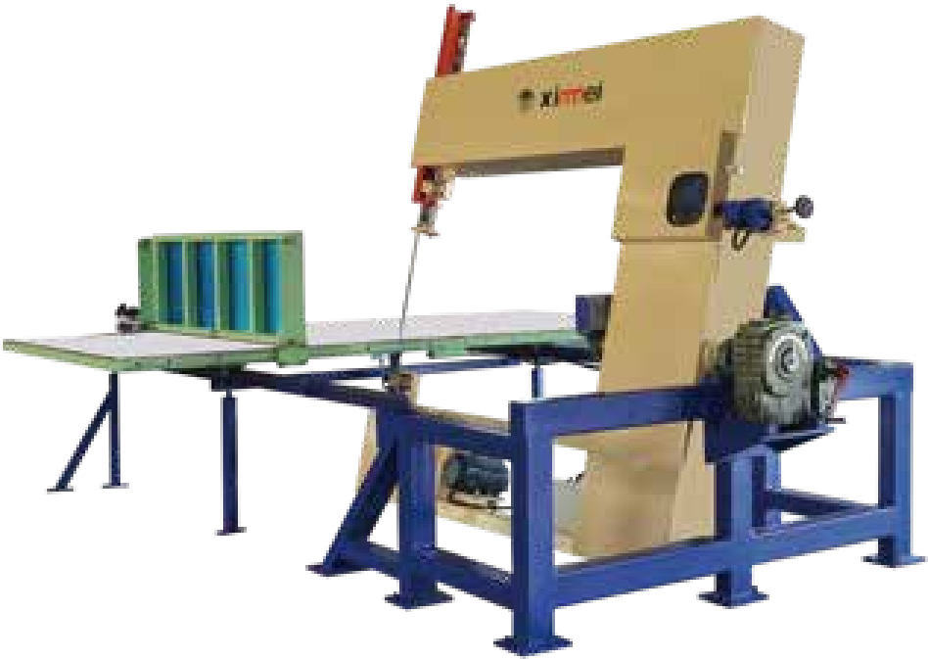
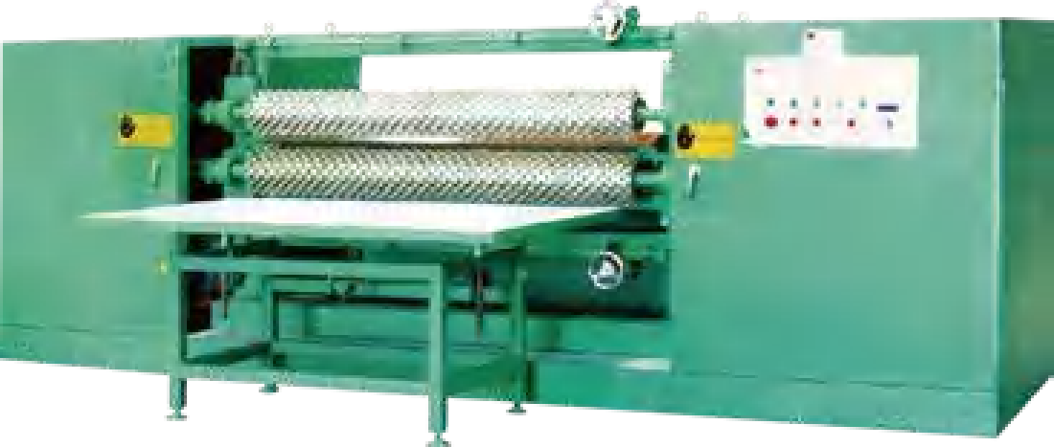





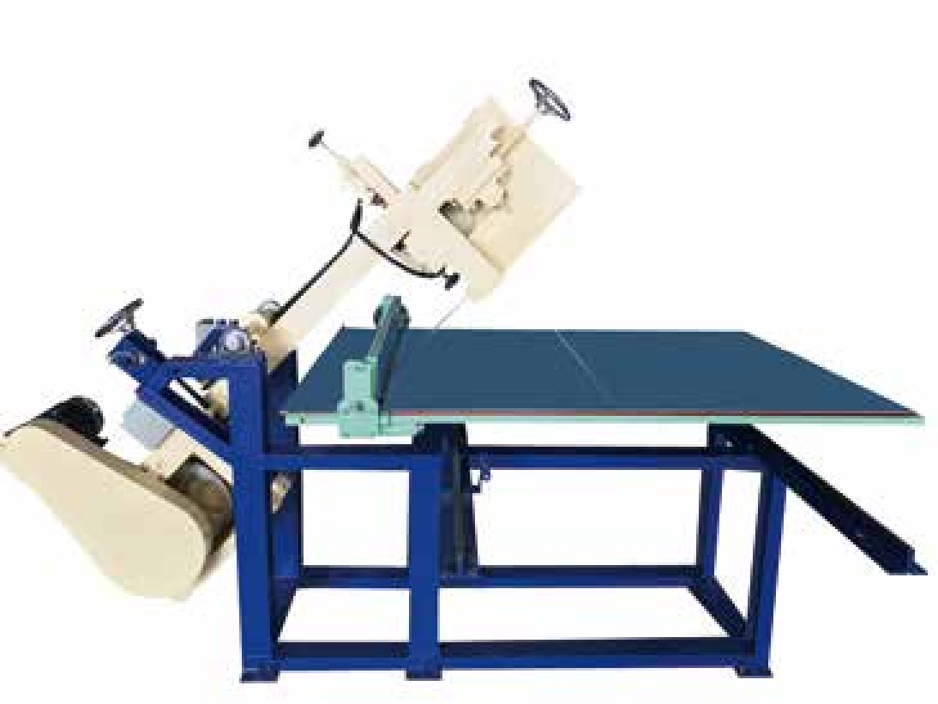
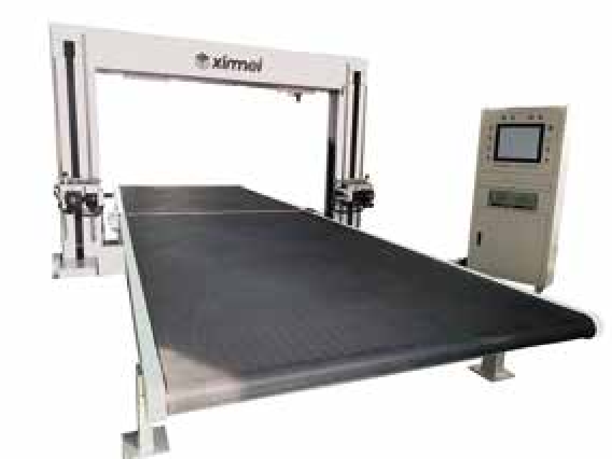
ximnei 切割系列 CUTTiNG SERIES
TDA 角度切割机
TDAAngular Cutting Machine
TDA-2000 Profile Compression Cutting Machine
这种切割机可以把 PU 海绵或橡塑产品切成斜坡 , 用于家具和其他行业 的特殊要求加工 , 切割成45o 90o 的斜坡。
本机为压形切割机械 , 主要将泡绵压成波浪状绵。适用于电子、精密仪器、汽车座垫、保健用品 , 床垫 , 以及水果包装等包装用途。
This machine mainly presses the foam into wave-like. Suitable for electronics, precision instruments, automobile seat cushions, health care products, mattresses, and fruit packaging and other packaging purposes.
This cutting machine can cut PU sponge and other rubber-plastic materials into slopes on all sides for special requirement processing in furniture and textile industry, cutting into beveled edges with angle 45°-90° .
最大压形宽度 Max profiling width | 2000mm
压形输轴转速 Profiling roller rotation speed | 0 ~ 1 5r/min
刀带长度 Band knife length | 9400mm
最大压形深度 Max profiling depth | 30mm
切割速度 Cutting speed | 0 ~ 25m/min
电机功率 Motor power | 9 . 94kw
机器重量 Machine weight | 3800kg
外形尺寸(长 宽x高) overall dimension(LXWXH) | 4800x4300x 1400mm
切割角度/ Cutting angle | 45°-90°
电机功率/ Motor _{power} | 1 . 68kw
机器重量/Machine weight | 1800kg
机器外形尺寸(长x宽x高) Machine external size(LXWXH) | 4000x4000 2500mm
TDP Sponge Angle cutting machine
TDPF-01 Dual Oscillating blade vibration knife Contour Machine
这种切割机可以把 PU 海绵和其他橡塑材料四边切成斜坡 , 用于家具和纺织行业特殊要求加工 , 切割成角度 45°-90° 的斜边。
实现简单的三维切割和替代单件无内孔的冲床模切泡绵制品 , 大大提高了三维产品的切割精度和模切加工的工作效率 , 也从根本上弥补了通过 旋转工作台面实现简单三维切割的同类机械无法实现薄片异型加工的弊端。
Realize simple 3D cutting and replace the single piece of foam products without holes in the punch press die-cutter, greatly improving the 3D product cutting accuracy and die-cutting processing efficiency. Also fundamentally make up for by rotating the table to realize the simple 3D cutting of similar machinery can not realize the disadvantages of thin sheet profiled processing.
This cutting machine can cut PU sponge and other rubber-plastic materials into slopes on all sides for special requirement processing in furniture and textile industry, cutting into beveled edges with angle 45°-90° .
块料最大尺寸 Maximum block size | 3000x2300x 1300mm
刀具参数 Cutting tool | 2400x3xo. 5mm 1 600x3xo. 5mm
伺服系统 Servo system | 2400 - 2800r/min
最大加工线速度 processing speed | 0 - 6 . 3m/min
加工精度 Cutting tolerance | ±0 . 5mm
最小切割尺寸 Minimum cutting size | 5mm
机械总功率Total power | 1 0KW
机械重量 Machine weight | 3000kg
机械尺寸 Machine dimension | 6480x3200x2300mm
切割角度 cutting Angle | 45°-90°
电机功率 Motor power | 1 . 68kw
机器重量 Machine weight | 1000kg
外形尺寸(长 宽x高) overall dimension(LXWXH) | 2000x 1 000x2000mm
1 1/1 2

Slide 8








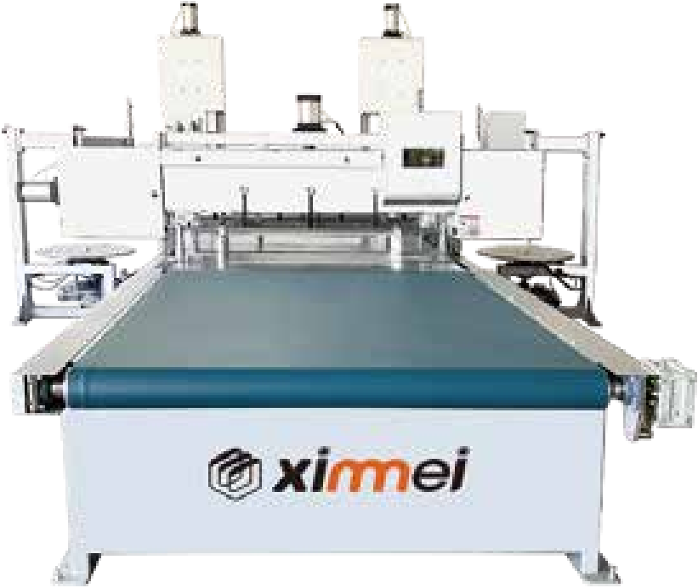
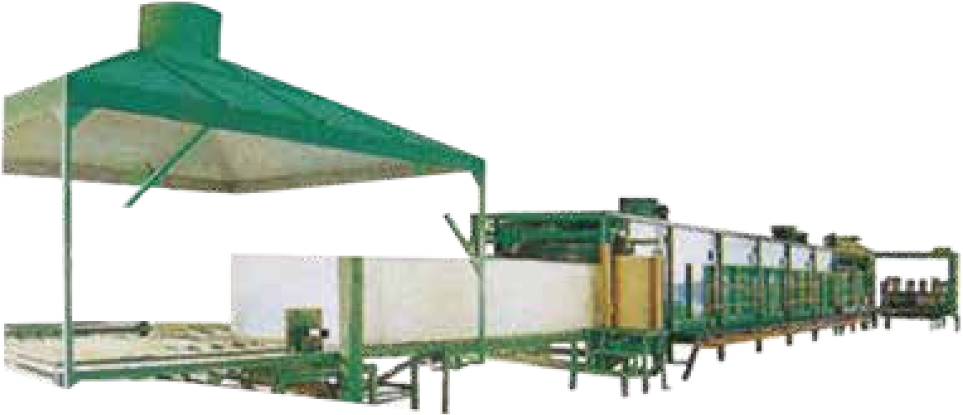







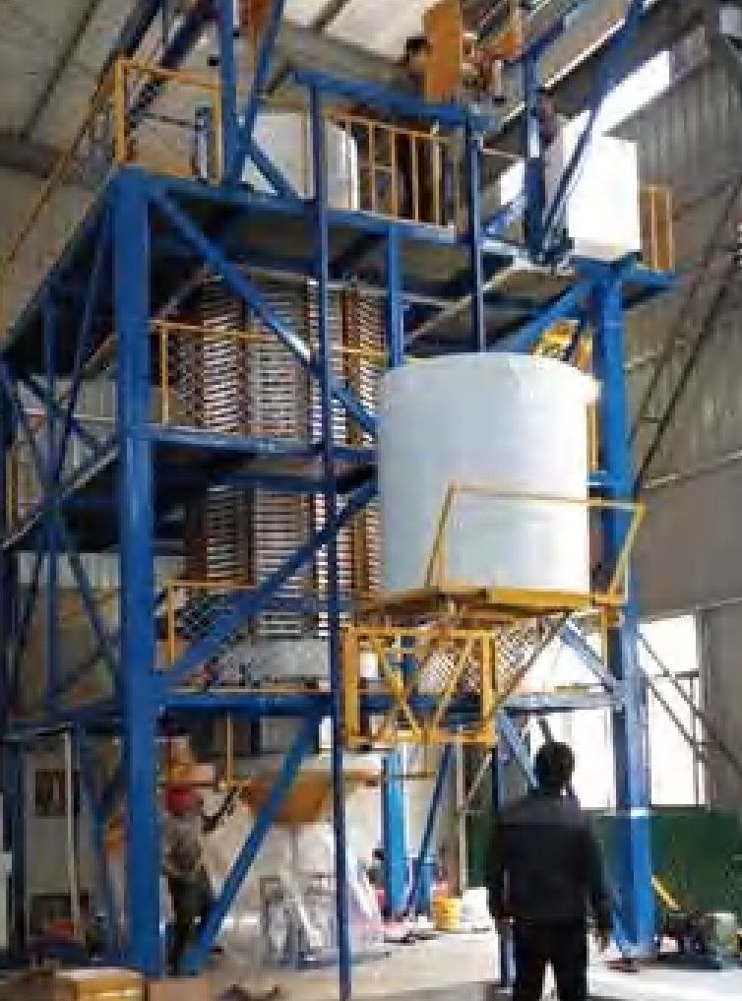
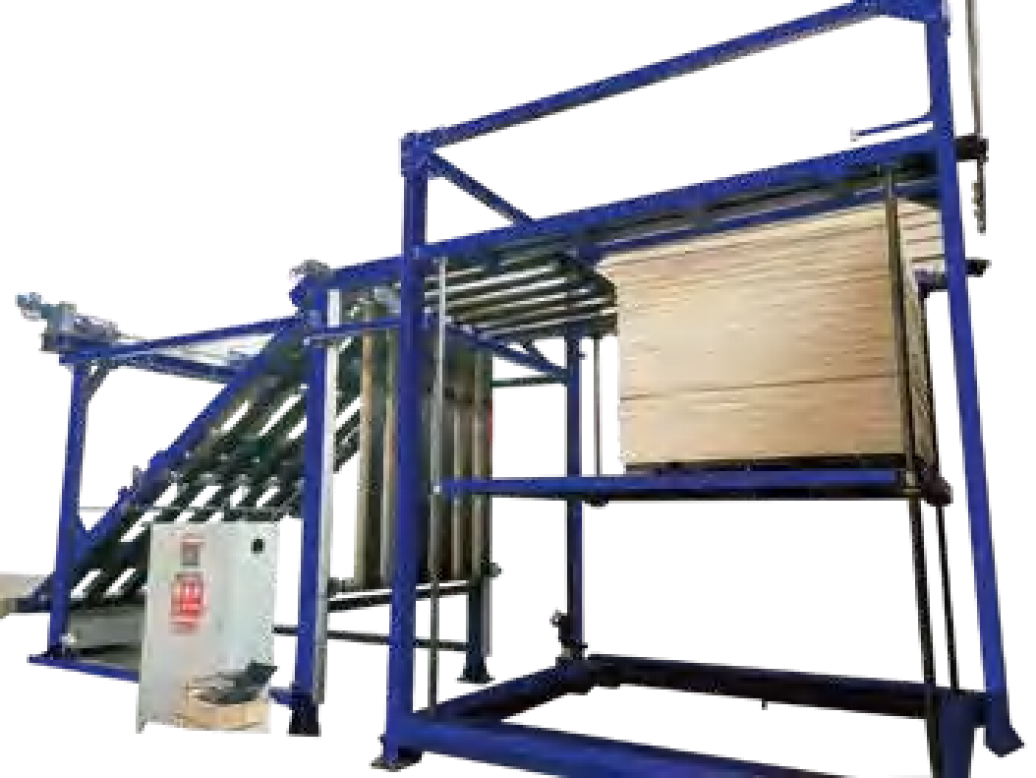
XInnneJ
ximnei 发泡系列 FOAMING/REBOND FOAMING SERIES
TDP-02 Automatic edge Trimming machine
TDP-2650 Horizontal Continuously Automatic Polyether foaming Product Line
本机主要用于 PU 海绵 , EVA, PE, EPE ,XPE 等材料的精加工 , 把无限长的物料先切去两边不齐的地方 , 再把物料切断成所需要的长度尺寸 , 收卷部 分把两边裁切下来的物料卷成卷便于储存。这种机器可连接在复合机 , 和切割机后面 , 裁切可不用停机 , 实现连续不断地裁切 , 可省时省工 , 提高效率。
This machine is mainly used for PU sponge, EVA, PE, EPE, XPE and other materials finishing. The infinite length of the material first cut off the two sides of the uneven place and then cut the material into the required length size. The winding part in two sides roll the cut material for easy storage. This machine can be connected behind the laminating machine and cutting machine, cutting can be without stopping, realize continuous cutting, can save time and labor, improve efficiency.
本设备主要适用于8 … 120 kg I m3 密度的聚氨酯泡沫生产 , 具有自动化程度高、生产成本低、操作简便等优点 , 是从事生产汽车 , 家私、鞋材、文 胸、电子、制衣以及汽车工业用泡沫最为理想的生产设备。
This equipment is mainly suitable for the production of PU foam with the density of 8-120 kg/m³ . It has the advantages of high automa- tion, low production cost and easy operation. It is the most ideal production equipment for producing foam for automobile, furniture, shoes, bra, electronics, clothing and automobile industry.
烘箱长度/ Oven rack length | 18m
侧板调节宽度/ Side panel adjustment width | 930 - 2300mm
连接传送带长度 Conveyor length | 25m
连接传送带速度/ Conveyor speed | 2 - 6 . 5m/min
发泡高度/ Foaming height | 0 .4- 1250mm
混合头电机功率/ Mixing motor _{power} | 37kw
生产能力 Production capacity | 8000 … 15000 (kg/h)
总功率/ Total power | 130kw
机器重量/Machine weight | 30000kg
机器外形尺寸(长x宽x高) Machine external size(LXWXH) | 36000 ×4500×3700mm
裁切宽度 cutting width | 1 000 - 2000mm
裁切厚度 cutting thickness | 1 - 1 00mm
裁切密度 cutting density | 15 - 200 kg/m³
裁切速度 cutting speed | 1 - 20m/min
电机总功率Total motor power | 1 0kw
电机总重量 Gross motor weight | 5000kg
外形尺寸(长 宽x高) overall dimension(LXWXH) | 6424x4600x2786mm
TDPH-01 Automatic palletizer
TDP-1500 Vertical Continuously Round Foam Foaming Machine
本设备主要适用于8 ~ 50kg I m3 密度的软体质聚氨酯泡沫生产 , 具有自动化程度高、生 产成本低、操作简便等优点 , 是从事生产家私、鞋材、文胸、电子、制衣以及汽车工业用泡沫 最为理想的生产设备。
This equipment is mainly suitable for the production of flexible polyurethane foam with density of 8~50kg/m³ . It has the advantages of high automation, low production cost and easy operation. It is the most ideal production equipment for the production of foam for home furniture, shoes, bra, electronics, clothing and automobile industry.
本机主要用于海绵、EVA、PE 等各种片材的自动码垛堆高 , 本机全部采用伺服电机 , 运行平稳 , 码垛整齐 , 是自动切割机器的配套产品 , 节省人工 , 效率更高。
This machine is mainly used for automatic palletizing and stacking of various sheets such as sponge, EVA, PE, etc . This machine adopts servo motors, running smoothly and palletizing neatly. It is a supporting product of automatic cutting machine, saving labor and more efficient.
发泡直径 Foaming Diameter | Φ1 . 2 - 1 . 5m
提升速度 Lifting speed | 0 - 3m/min
发泡头流量 Foaming flow | 90L/min
发泡密度 Foaming density | 10 - 50m3
发泡头转速 Rotation speed | 3000 - 5000rpm
生产能力 production capacity | 3000kg/h
总功率Total power (kw) | 56kw
机器重量 Machine weight (kg) | 12000kg
机器外形尺寸(长x宽x高) Machine external size(LXWXH) | 4000x6000x8500mm(不包括料罐和控制部分 Tanks and controls are not included)
码垛物料尺寸 palletizing material size | 3000x2000mm
码垛速度 palletizing speed | 60m/min
码垛高度 palletizing height | 2800mm
电机总功率Total motor power | 1 7 . 2kw
机器重量 Machine weight | 8500kg
外形尺寸(长 宽x高) overall dimension(LXWXH) | 1 0000x21 00x3600mm
1 3/14

Slide 9



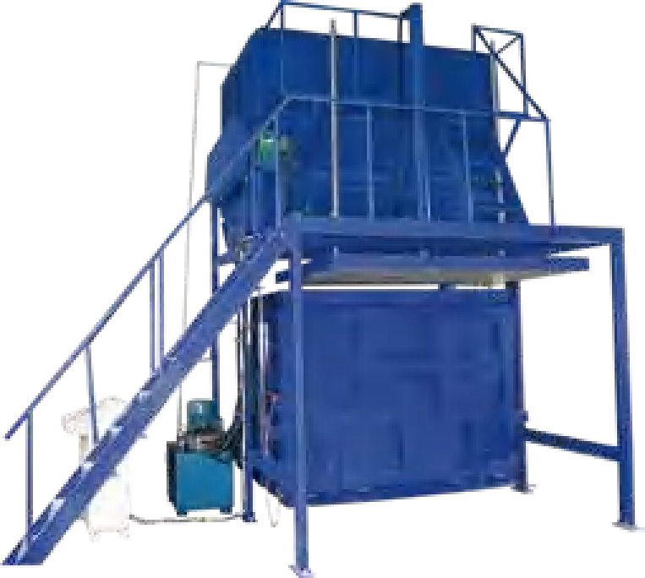
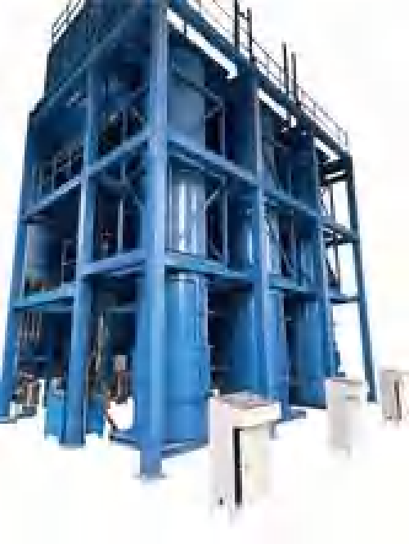









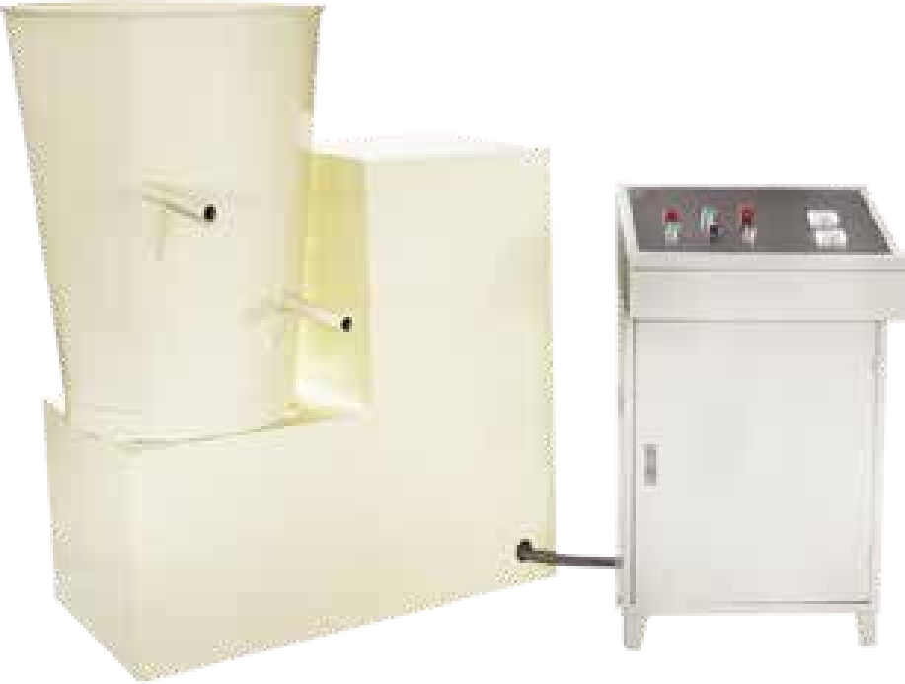
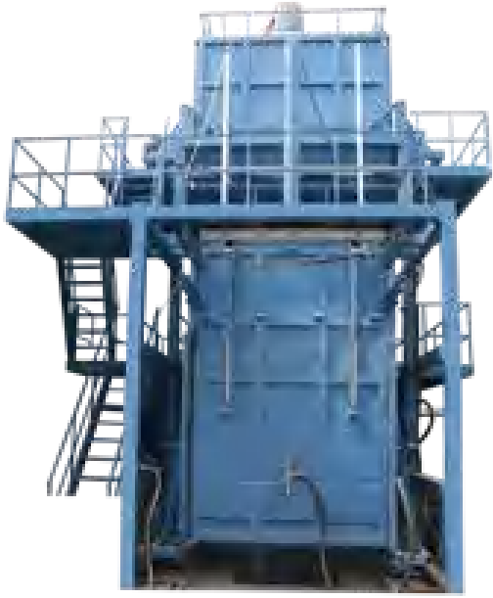
ximnei 发泡系列 FOAMING/REBOND FOAMING SERIES
TDPF-04 Rebonded cylinder foam Triple Foaming work line
TDP-10 Rebonded Foam Production line
本机主要用于 PU 海绵 , 橡胶 , PE, EVA, EPE 等材料的废旧利用 , 把海绵、PE、EVA , EPE 的边角料粉碎、加入胶水搅拌、再加压成型。用蒸汽或自然干 燥把胶水和碎料粘合成圆泡 , 再用圆切机切割成无限长的薄片 , 复合上 PE 膜或布料。用于地毯下面铺垫或地板垫及鞋材等用途。
This machine is mainly used for the waste utilization of PU sponge, rubber, PE, EVA, EPE and other materials. Crush the sponge, PE, EVA, EPE edges, add binder and mix, then pressurize and mold. Use steam or natural drying to bond the binder and crushed material into cylinder foam, then use a cylinder peeling machine to cut into infinitely long sheets, laminated with PE film or fabric.
Used for applications such as under carpet padding or floor mats and shoe materials.
本机主要把碎海绵与胶混合在 起加压 , 用蒸汽成型或者自然干燥。产品主要用于健身器、汽车、体育垫、家私、鞋业、牛床垫、地垫、装潢等行业。
This machine mainly mixes the crushed sponge with binder and pressurizes them together, and molds them with steam or dries them
naturally. The products are mainly used in fitness equipment, automobile, sports mat, home furniture, shoes, cattle mats, floor mat, decoration and other industries.
发泡尺寸 (直径x长) Foam size | (1000 - 1300)x(L1200 - 2200)mm
搅拌箱容积 Mixing tank volume | 15m3
生产能力 productive capacity |  | moul |  | d/h)
生产密度 production density | 50 - 300 kg/m3
电机总功率Total motor power | 75kw
机器重量 Machine weight | 60000kg
外形尺寸 (长x宽x高)Overall dimension (LXWXH) | 9770x6683x 1 3305mm
搅拌容积stirring volume | 15m3
泡体尺寸(长x宽 高)/Foaming size(LXWXH) | 21 00x1 800x 1 000mm
搅拌速度stirring rate | 40r/min
生产能力 productive capacity | 3模/小时(3 mould/h)
电机功率 Motor power | 33kw
机器重量 Machine weight | 8000kg
外形尺寸(长 宽x高) overall dimension(LXWXH) | 4000x4000x5400mm
d e
TDPB-A Rebond Cubic foam Foaming Machine
TDP-16 Manual Foaming Machine
生产出的产品密度均匀，突破了以往再生发泡机，发泡上下密度误差太大的弊端。最大的特点是一箱可以发出多个尺寸，无需换箱。本机主要把粉 碎好的泡绵、橡胶、EVA、EPE 等碎原料用胶水混合搅拌、加压，加蒸汽成型或自然固化。生产出的产品经过切割加工后可用于健身器材、体操垫、牛床 垫、汽车内饰、鞋材、地垫、装潢等行业，用途广泛，节省成本。
The density of the products produced is uniform, breaking through the disadvantages of the previous rebond foaming machine
foaming the upper and lower parts of the density difference is too large.The best feature is that multiple width sizes can be produced in one tank, no need to change tanks. This machine is mainly crushed foam, rubber, EVA, EPE and other crushed raw materials with binder mixing
and stirring, pressure, steam molding or natural solidification. Produced products after cutting and processing can be used for fitness
equipment, gymnastics mats, cattle mattresses, automobile interiors, shoes, mats, decorating and other industries, versatile and cost-saving.
这种发泡机采用变频调速控制装置。把原料放在发泡桶里进行混合搅拌 , 通过高速与低速独立调速控制 , 混合速度每分钟 。到 1500 转。
This kind of foaming machine adopts frequency conversion speed control device. The raw materials are put in the foaming barrel for mixing and stirring, and the mixing speed is from 0 to 1500 rotations per minute through the independent speed control of high and low speed.
转速 Rotation speed | 0 ~ 1500rpm
日生产量 Daily output | 6 ~ 8ton
发泡桶容量Foaming tank capacity | 80 ~ 150kg
电机功率Motor power | 7 . 5/1 1 kw
机器重量Machine weight | 600kg
机器外形尺寸(长 宽x高) Machine external size(LXWXH) | 1200 x 600 x 1 000mm
发泡尺寸(长x宽x高) Foam size (LXWXH) | 2100x(1 100 - 2000)x(600 - 1200)mm
发泡密度 Foam density | 50 - 300 kg/m³
生产能力 productive capacity | 3 Moulds/Hour
密度误差 Density difference | ±5 kg/m³
电机功率 Motor power | 46kw
机器重量 Machine weight | 1 6ton
外形尺寸(长 宽x高) overall dimension(LXWXH) | 7695x6235x9407mm
1 5/1 6

Slide 10






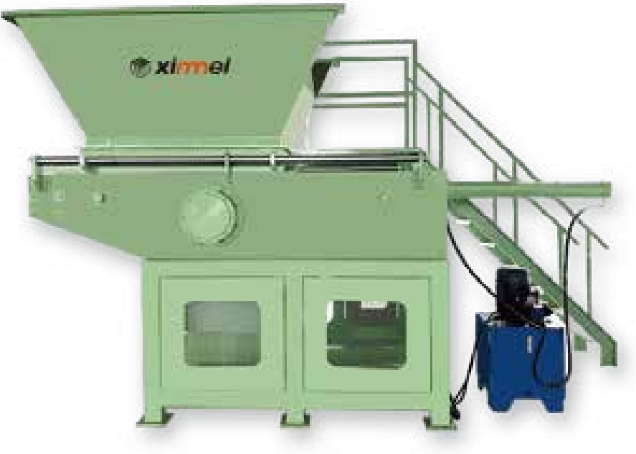
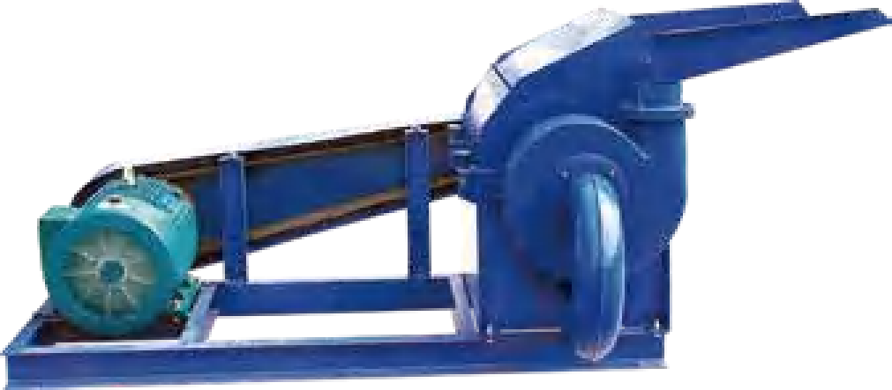






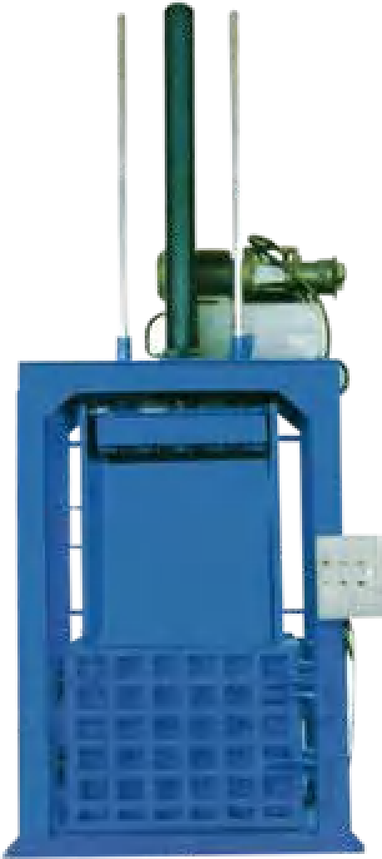
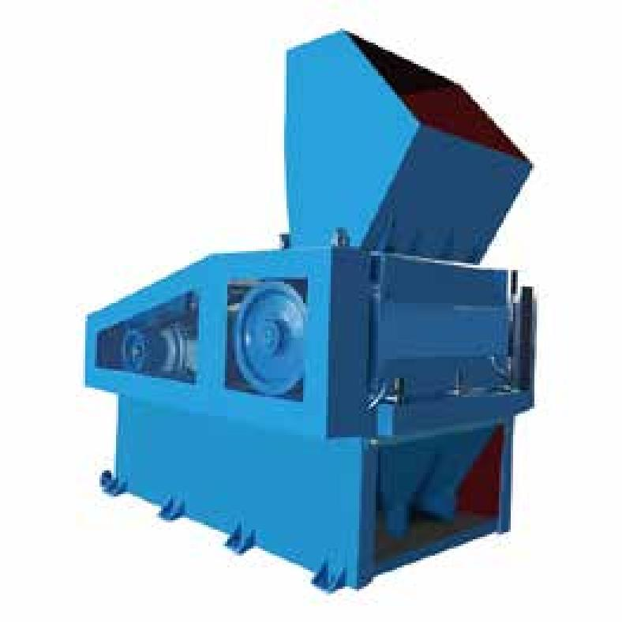
ximnei 撕碎打包系列 SHREDDING/BALING SERIES
TDP-S-7/8
TDP-S-7/8 Sponge Shredding Machine
TDP-S-1/2 Sponge Crushing Machine
本机主要用于将紧密打包的整包 PU 海绵撕碎成小块海绵 , 再经过粉碎机粉碎。与再生海绵生产线配套做成再生海绵; 或粉碎后做填充料。本机 功率强大 , 生产效率高。
This machine is mainly used to shred the tightly baled whole package of PU sponge into small pieces of sponge, and then crushed by the crusher. It can be used to make rebonded sponge by matching with rebond sponge production line; or crushed to make filler material. This machine has strong power and high production efficiency.
本机主要用于泡绵边角料的粉碎后再回收利用 , 与再生海绵生产线配套做成再生海绵; 或粉碎后做填充料。本机功率强大 , 出风力强 , 生产效率 高 , 缺点 , 噪音大 , 故障率高。
This machine mainly used for crushing foam scrap for recycling, and matching with rebond sponge production line to make rebonded sponge or crushed to make filler material. This machine is powerful, strong wind, high production efficiency. The disadvantage is the noise, high failure rate.
型号 Model number | TDP-S- 1 | TDP-S- 2
破碎速度 Crushing speed | 150kg/h | 300kg/h
破碎粒度 Curshing granule size | 2 - 30mm | 2 - 30mm
电机功率 Motor power | 1 5kw | 30kw
机器重量 Machine weight | 700kg | 1000kg
外形尺寸 (长×宽x高) overall dimensions(LXWXH) | 1 500x500x800mm | 1800x600x 1 000mm
型号 Model number | TDP-S- 7 | TDP-S- 8
撕碎速度 Shredding speed | 2000kg/h | 3000kg/h
撕碎颗粒shredded granule | 50 - 1 00mm | 50 - 1 00mm
进料口尺寸 Feed port size | 1100 W×1250 L mm | 1350x 1400mm
电机功率 Motor power | 55kw | 75kw
机器重量 Machine weight | 8000kg | 10000kg
外形尺寸 (长 宽x高) overall dimensions(LXWXH) | 2900x2300x2800mm | 3200x2600x3000mm
TDP-S-4 Low noise knife Crushing Machine
TDB-01 Vertical Baler
本机主要用于粉碎 PU 海绵 、布绵 、PE、EVA、塑料和橡胶等。可和 PU 海绵再生设备配套使用 , TDP-S-4型粉碎机带有隔音降噪装置 , 其优点粉碎 效率高 , 噪音小故障率低 , 粉碎安全。
This machine is mainly used for crushing PU sponge, quilted fabric, PE, EVA, plastic and rubber. Can be used with PU sponge rebonded equipment. TDP-S-4 crusher with sound insulation noise reduction device. Its advantages of high
crushing efficiency, low noise, low failure rate, crushing safety.
本机器主要是将大块泡绵压实使其体积缩小 , 然后将其包装以方便运输。
This machine is mainly used to compact large pieces of foam to reduce its size, and then pack it for easy transportation.
转子尺寸 (直径x长度) Rotor size | y600× 1200mm (length)
粉碎能力(筛网 ^{strainer} 15mm 、kg/h crushing capacity | 1200 - 200okg/h (40mm)
入料口宽度 Inlet width | 1 200mm
电机功率 Motor power | 75kw
整机重量 Machine weight | 5600kg
外形尺寸 (长 宽x高) overall dimension(LXWXH) | 2500x21 00x2900mm
最大泡绵尺寸 Maximum foam size | 900x700x1 00omm
最大行程 Maximum stroke | 800mm
电机功率 Motor power | 7 . 5kw
机器重量 Machine weight | 2500kg
外形尺寸 (长x宽x高)Overall dimension (LXWXH) | 1300x1 1 200x3000mm
1 7/1 8

Slide 11





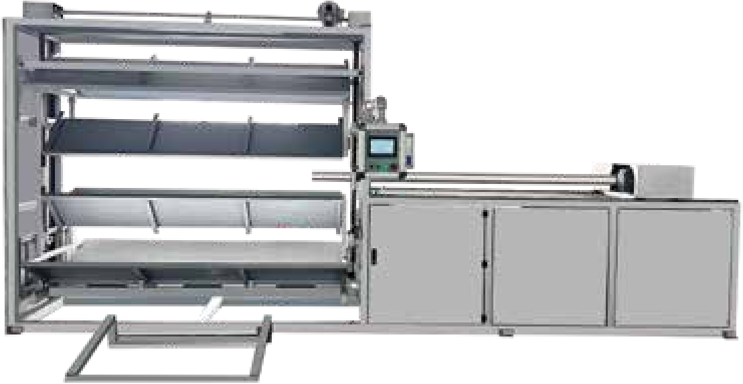
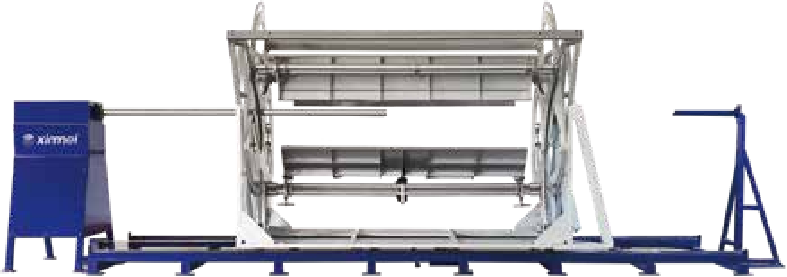



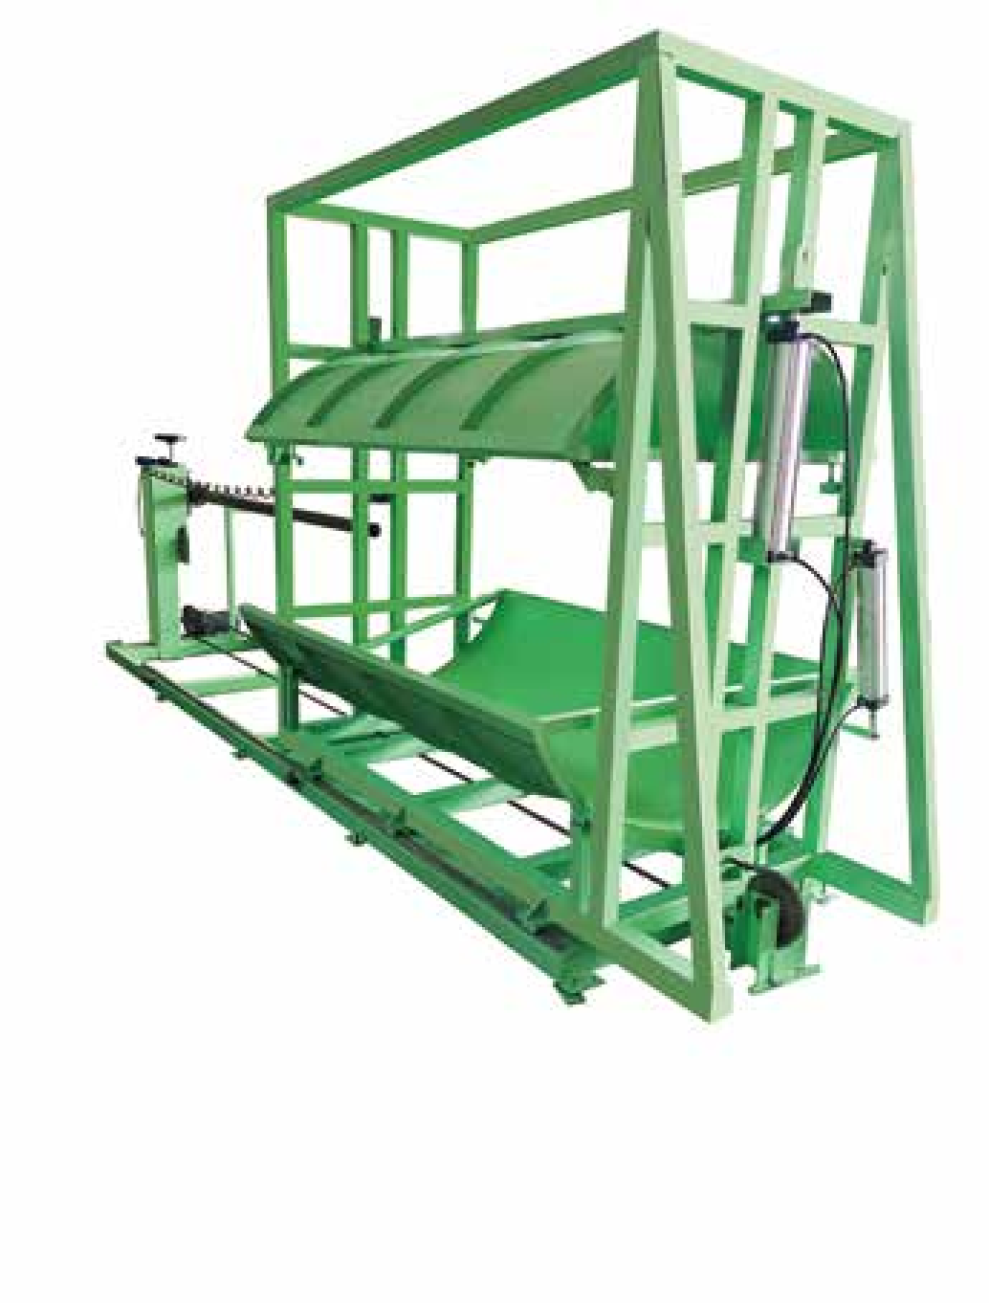
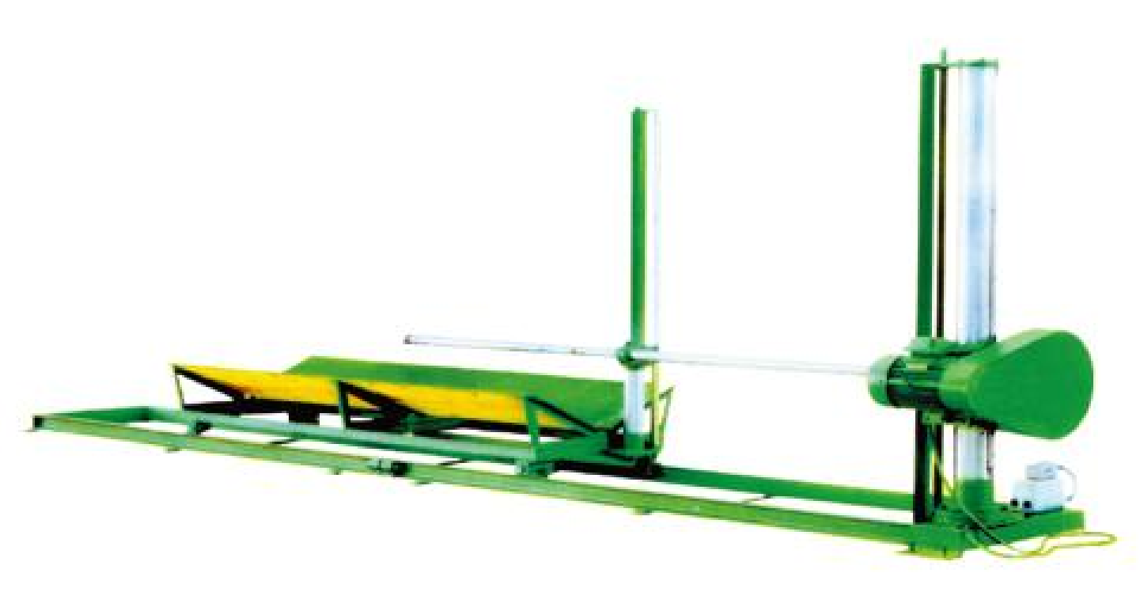
ximnei 打孔系列 BORING SERIES
C518 Automatic Boring and Threading in one Machine
C519 Automatic Boring Machine
本机主要配套垂直圆泡发泡机和圆切机使用 , 把圆泡中心打上孔 , 便于圆切机切割无限长海绵 。C518型打孔机的优点在于它比任何 款打孔机 打孔精准 , 采用三个方向抱夹 , 自动找正海绵中心 , 海绵废料减少 , 海绵利用率高 , 穿杠不用人工 , 自动穿杠省时省力 。
This machine is mainly used with vertical cylinder foam Foaming machine and Peeling skiving machine, the center of the cylinder foam is punched with holes, which is convenient for peeling machine to cut unlimited length sponge. The advantage of C518 per-
forating machine is that it is more accurate than any boring machine, it adopts three-direction clamping, it is automatic to find out the
center of the sponge, the waste is reduced, the sponge is utilized at high rate, it does not need to be manually threaded, automatic to thread
本机为泡绵圆切机配套 , 自动实现圆泡、方泡 PU 海绵中间打孔加工。主要优点为方泡、圆泡都可打孔 , 自动进给。
This machine is a good match for the foam Peeling Machine, automatically realize the cylinder foam, cubic foam PU sponge middle hole boring processing. The main advantage is that cubic foam, cylinder foam can be well perforated, automatic feeding.
the sponge supporting bar, which saves your time and effort.
钻孔直径 Hole diameter | 50 - 80mm
钻孔长度 Boring length | 2300mm
电机功率 Motor power | 4kw
机器重量 Machine weight | 1500kg
外形尺寸 (长 宽x高) Overall dimension (LXWXH) | 6000x 1 600x2500mm
钻孔直径 Hole diameter | 50 - 80mm
钻孔长度 Bore hole | 500 - 2300mm
海绵直径sponge diameter | 1200 - 1 500mm
电机功率 Motor power | 3 . 7kw
机器重量 Machine weight | 2000kg
外形尺寸(长 宽x高) overall dimension(LXWXH) | 6500×2000×2500mm
TDP-52 卧式泡绵钻孔机
TDP-52 Horizontal Boring Machine
TDP-63 Automatic Cylinder Foam Boring Machine
本机为泡绵圆切机的配套设备 , 自动实现圆形泡绵的中间钻孔加工。
This machine is the supporting equipment of foam peeling ma- chine, automatically realize the center drilling processing of
cylinder foam.
本机为泡绵圆切机的配套设备，主要用于圆形泡绵的中间钻孔加工。
This machine is the supporting equipment of peeling machine,and it is mainly used for boring a central hole in cylinder foam.
钻孔直径 Boring diameter | 45 ~ 80mm
主轴转速 Main shaft rotation speed | 230rpm/min
钻孔长度 Boring length | 500 - 2300mm
电机功率 Motor power | 3kw
机器重量 Machine weight | 1200kg
外形尺寸 (长 宽x高) overall dimensions(LXWXH) | 6000x 1 500x2500mm
钻孔直径 /Boring diameter | 45~80mm | 主轴转速 /Main shaft | 230r/min
钻孔长度 /Boring length | 2300mm | 电机功率 /Motor power | 1.5kw
机器重量 /Machine weight | 800kg | 机器外形尺寸 ( 长 X 宽 X 高 )/Machine external(LxWxH) | 6000x1500x1800mm
1 9/20

Slide 12







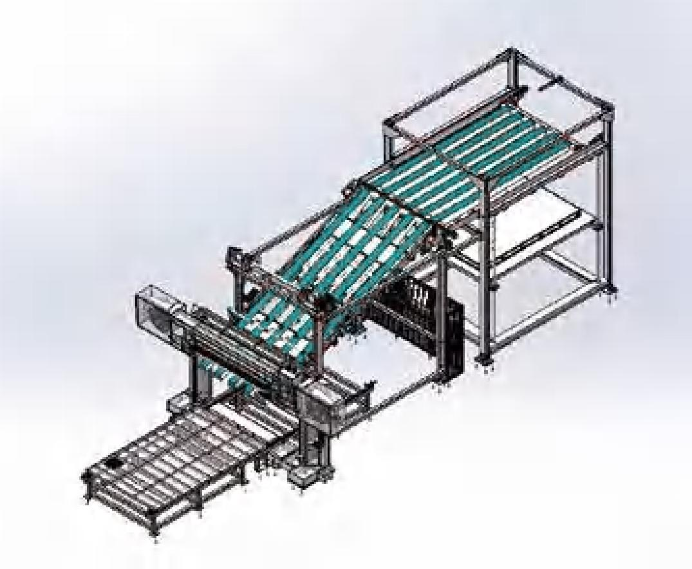
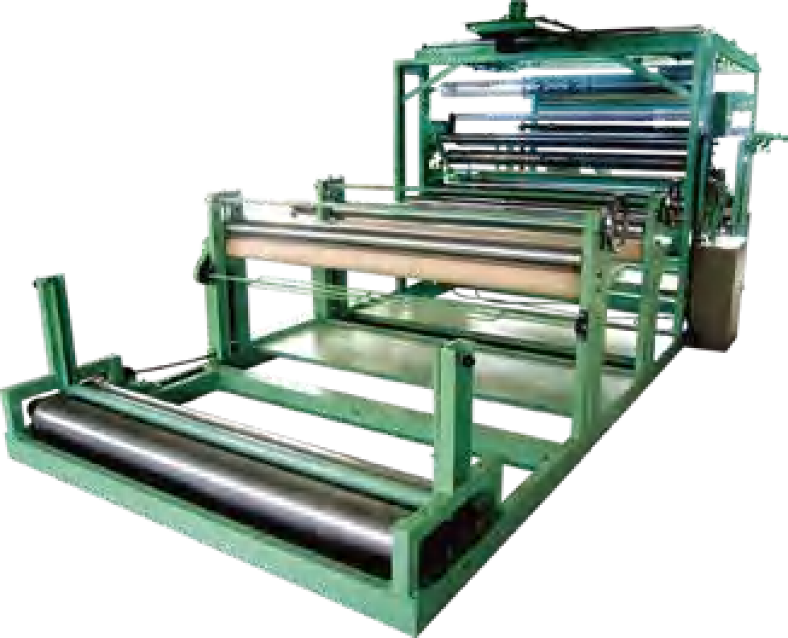





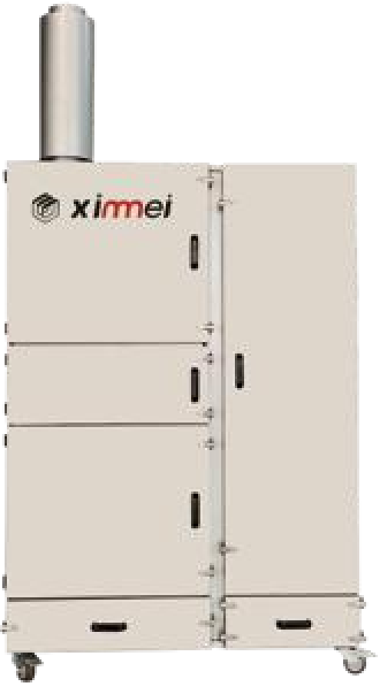
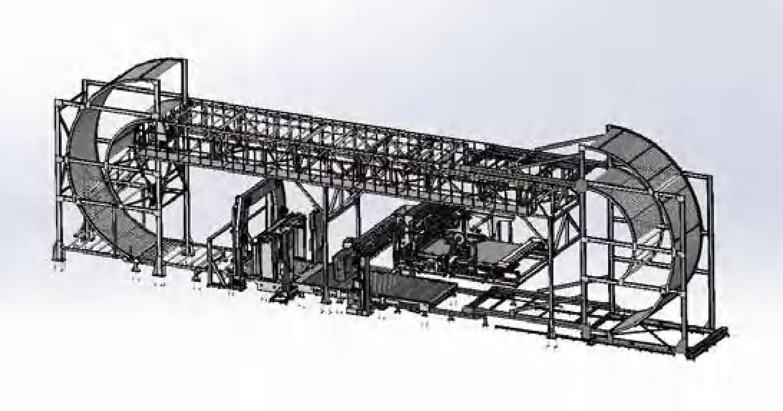
ximnei 其他 OTHERS
TDL-2200 Non heating Laminating Machine
Horizontal Splitting and Stacking Machine
本机器用于 PU 海绵 、EVA、PE 与布料、革、皮、无纺布、网等产品的上胶复合 , 适用于制鞋、服装、装潢、汽车 、地垫等行业。本机具有冷复合 , 不
用 PU 海绵水平切割机先把块状泡绵刨切成片状 , 再通过码垛机 自动堆成 定高度 , 这样既省去了用人工堆垛的繁琐 , 又做到了省工省 时 , 同时也提高了工作效率 , 更便于储存和装卸 。
First with PU sponge horizontal cutting machine, the foam cut into sheets, and then automatically stacked into a certain height by palletizing machine. This not only eliminates the manual stacking of trivial, but also saves labor and time, but also improves the effi- ciency of the work, more convenient for storage and loading and unloading.
用加温 , 具有省电降低成本之功效 , 平整无皱、粘合牢固等优点。
This machine is used for gluing and laminating PU sponge, EVA, PE and fabric, artifical leather, leather, non-woven fabric, net and other products. It is suitable for shoe making, garment, decoration, automobile, floor mat and other industries. This machine has the advantages of cold laminating, no need to heating, power saving
and cost reduction, flat and wrinkle-free, strong bonding, and so on.
幅宽 Laminating width | 2000 - 2200mm
复合速度 Laminating speed | 1 0 r 50m/min
电机功率 Motor power | 8kw
机器重量 Machine weight | 3000kg
外形尺寸(长 宽x高) overall dimension(LXWXH) | 7800x2200x2000mm
C516 Fireproof Dust Collector
Endless Long Foam Loop Horizontal Cutting Machine
C516 防火型集尘器是新美腾公司自主研发的 款高端磨刀用的吸尘器 , 它的优点是采用不锈钢滤芯 , 防火阻燃 , 配消音器降低了噪音 , 安装的旋风 分离器可以省去经常清洗滤芯的麻烦 , 节省人工。是圆切机、平切机、立切机磨刀必备产品 。有利于车间环境清洁干净。
主要把无限长的 PU 海绵粘接成环形 , 进行不间断的切割 , 这样可以极大的提高了工作效率 , 海绵也减少了浪费 。环切机的切割速度和精 度要优于其他的 PU 泡绵的水平切割设备。
Mainly bond the infinite length of PU sponge into a ring shape for uninterrupted cutting, which can greatly improve the working efficiency and reduce the waste of sponge. The cutting speed and precision of the loop cutting machine is superior to other horizontal
cutting equipment for PU foam.
C516 fireproof dust collector is a high-end vacuum cleaner for band knife grinding independently developed by Xinmeiteng. Its advantages are the use of stainless steel cartridge , fire retardant, with silencer to reduce the noise, the installation of the cyclone separator can save the trouble of frequent cleaning of the cartridge, saving labor. It is Peeling , Horizontal , Vertical Cutting Machine grinding knife necessary products. Favor the workshop
environment clean and tidy.
防火等级 Fire-proof level | A级 (不燃) Level A(non-combustible)
不锈钢滤芯 stainless steel filterca rtrid_{ge} | 2个1500目 2×1500 mesh
旋风分离器 cyclone separator | 1个 one
电机功率 Motor power | 1 . 5kw/2 . 2kw
电压 Voltage | 220V/380V
重量 Weight | 200kg
外形尺寸 (长 宽x高) overall dimension (LXWXH) | 12 × 5 × 750mm
21/22

